Slide 1
Cos’è il cambiamento climatico?
«Per “cambiamenti climatici” si intendono i cambiamenti a lungo termine delle temperature e dei modelli meteorologici. »
Cit. Nazioni Unite - Centro Regionale di Informazioni
https://unric.org/it/che-cosa-sono-i-cambiamenti-climatici/

Slide 2
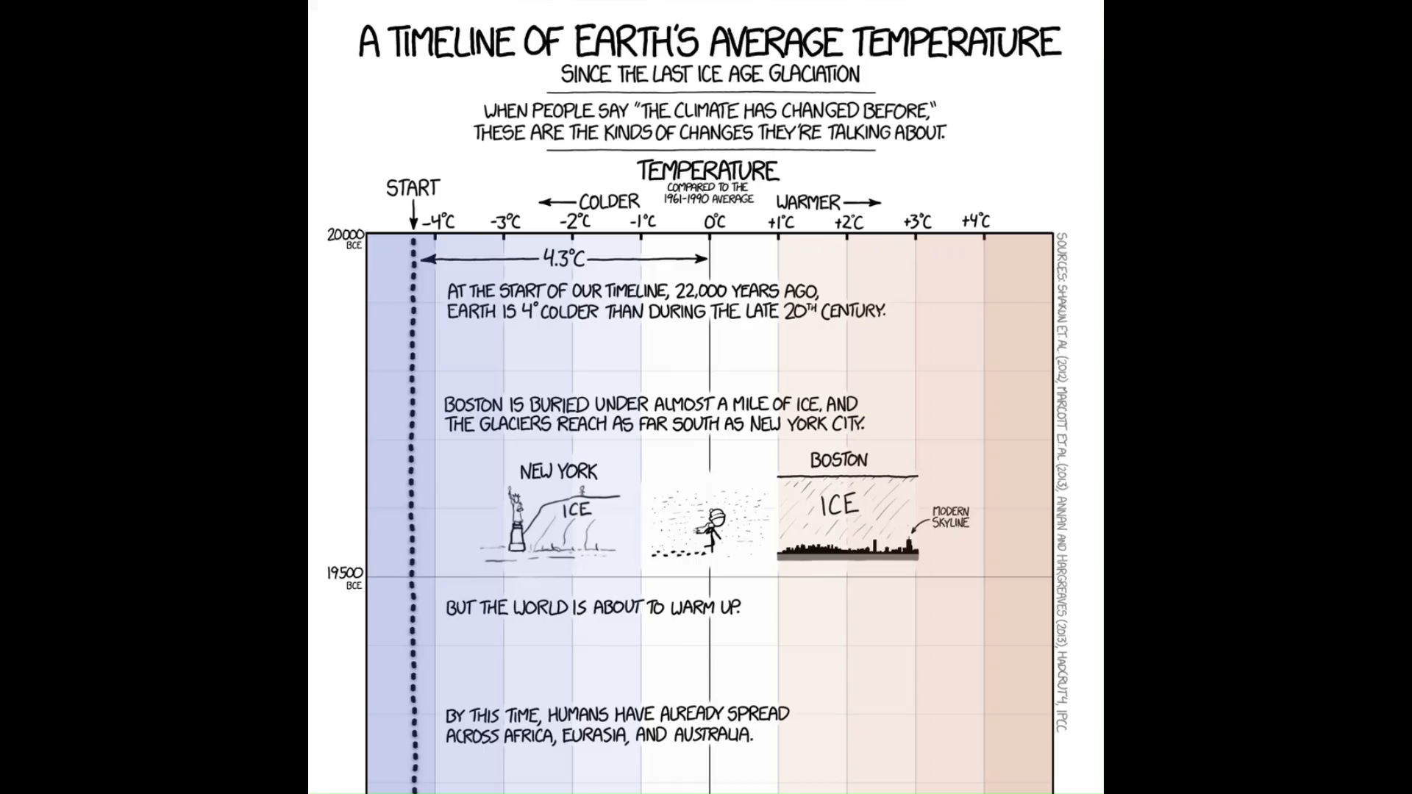
https://xkcd.com/1732/

Slide 3
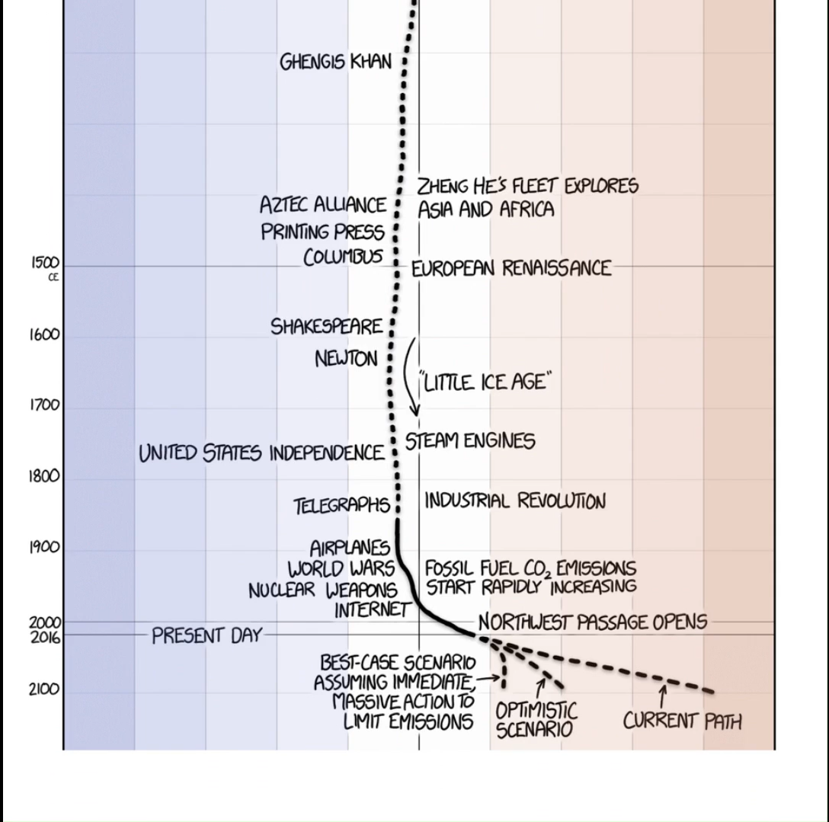
https://xkcd.com/1732/

Slide 4




🖼️ Framework scientifico
📩 Reperire i dati
⚙️ Analizzare/processare i dati
🗺️ Visualizzare i risultati
🤔 Interrogarsi sui risultati

Slide 5

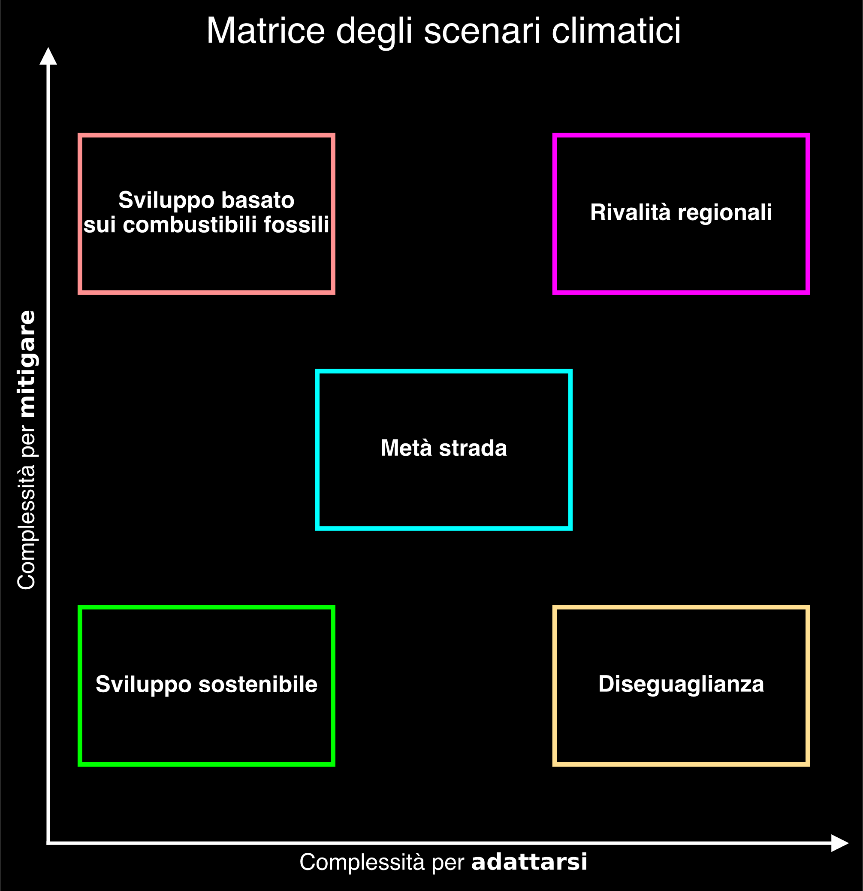

Slide 11

© IIASA and contributing modeling teams 2024

Slide 12
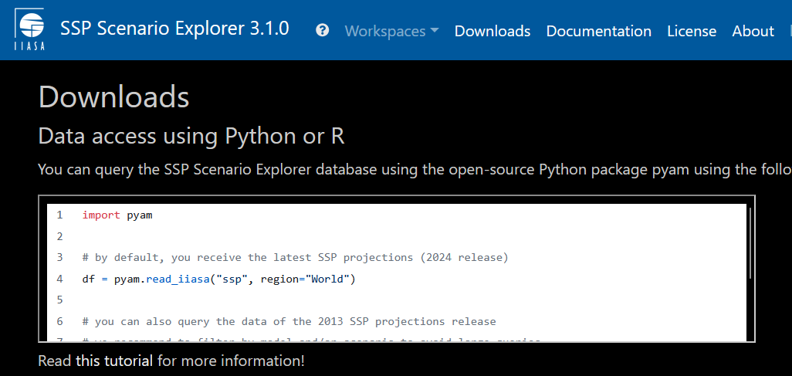
https://data.ece.iiasa.ac.at/ssp/#/downloads
© IIASA and contributing modeling teams 2024

Slide 17
Hannah Ritchie, Pablo Rosado, and Max Roser (2023) - “CO₂ and Greenhouse Gas Emissions” Published online at OurWorldinData.org. Retrieved from: 'https://ourworldindata.org/co2-and-greenhouse-gas-emissions' [Online Resource]

Slide 18
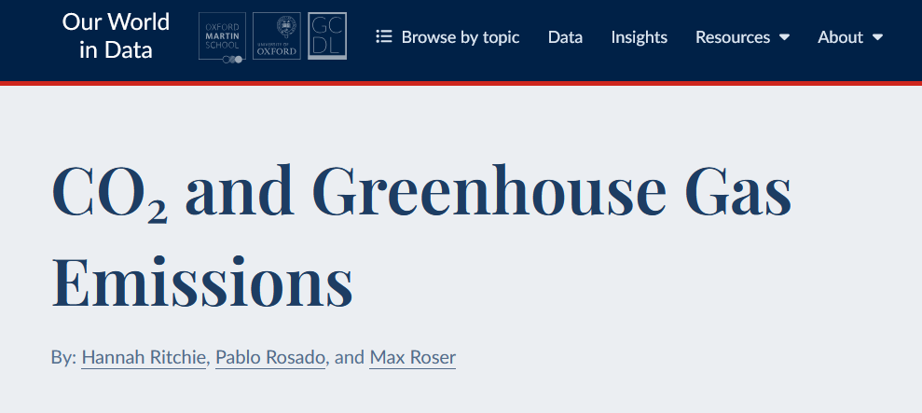
https://github.com/owid/co2-data
Hannah Ritchie, Pablo Rosado, and Max Roser (2023) - “CO₂ and Greenhouse Gas Emissions” Published online at OurWorldinData.org. Retrieved from: 'https://ourworldindata.org/co2-and-greenhouse-gas-emissions' [Online Resource]

Slide 19
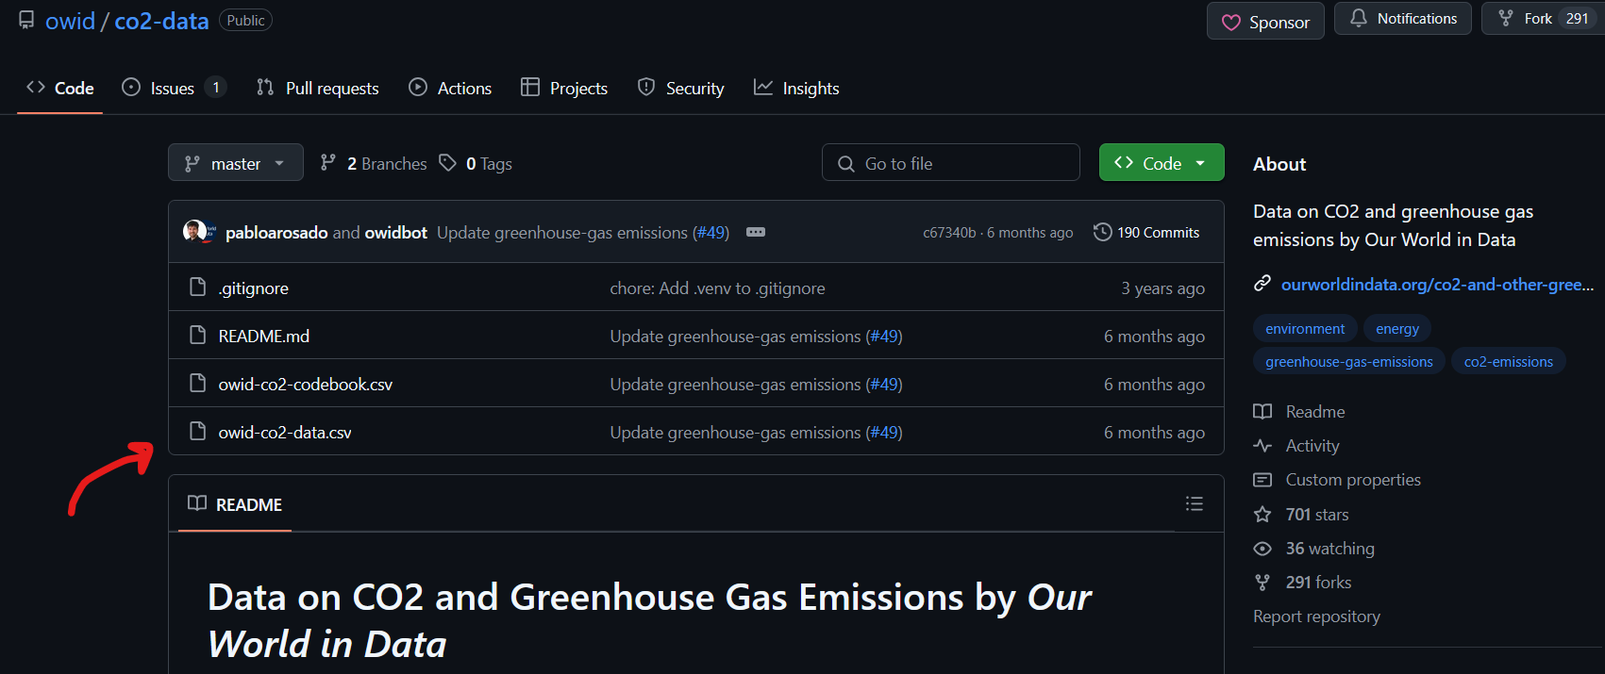
https://github.com/owid/co2-data
Hannah Ritchie, Pablo Rosado, and Max Roser (2023) - “CO₂ and Greenhouse Gas Emissions” Published online at OurWorldinData.org. Retrieved from: 'https://ourworldindata.org/co2-and-greenhouse-gas-emissions' [Online Resource]

Slide 22


Slide 23


Slide 24
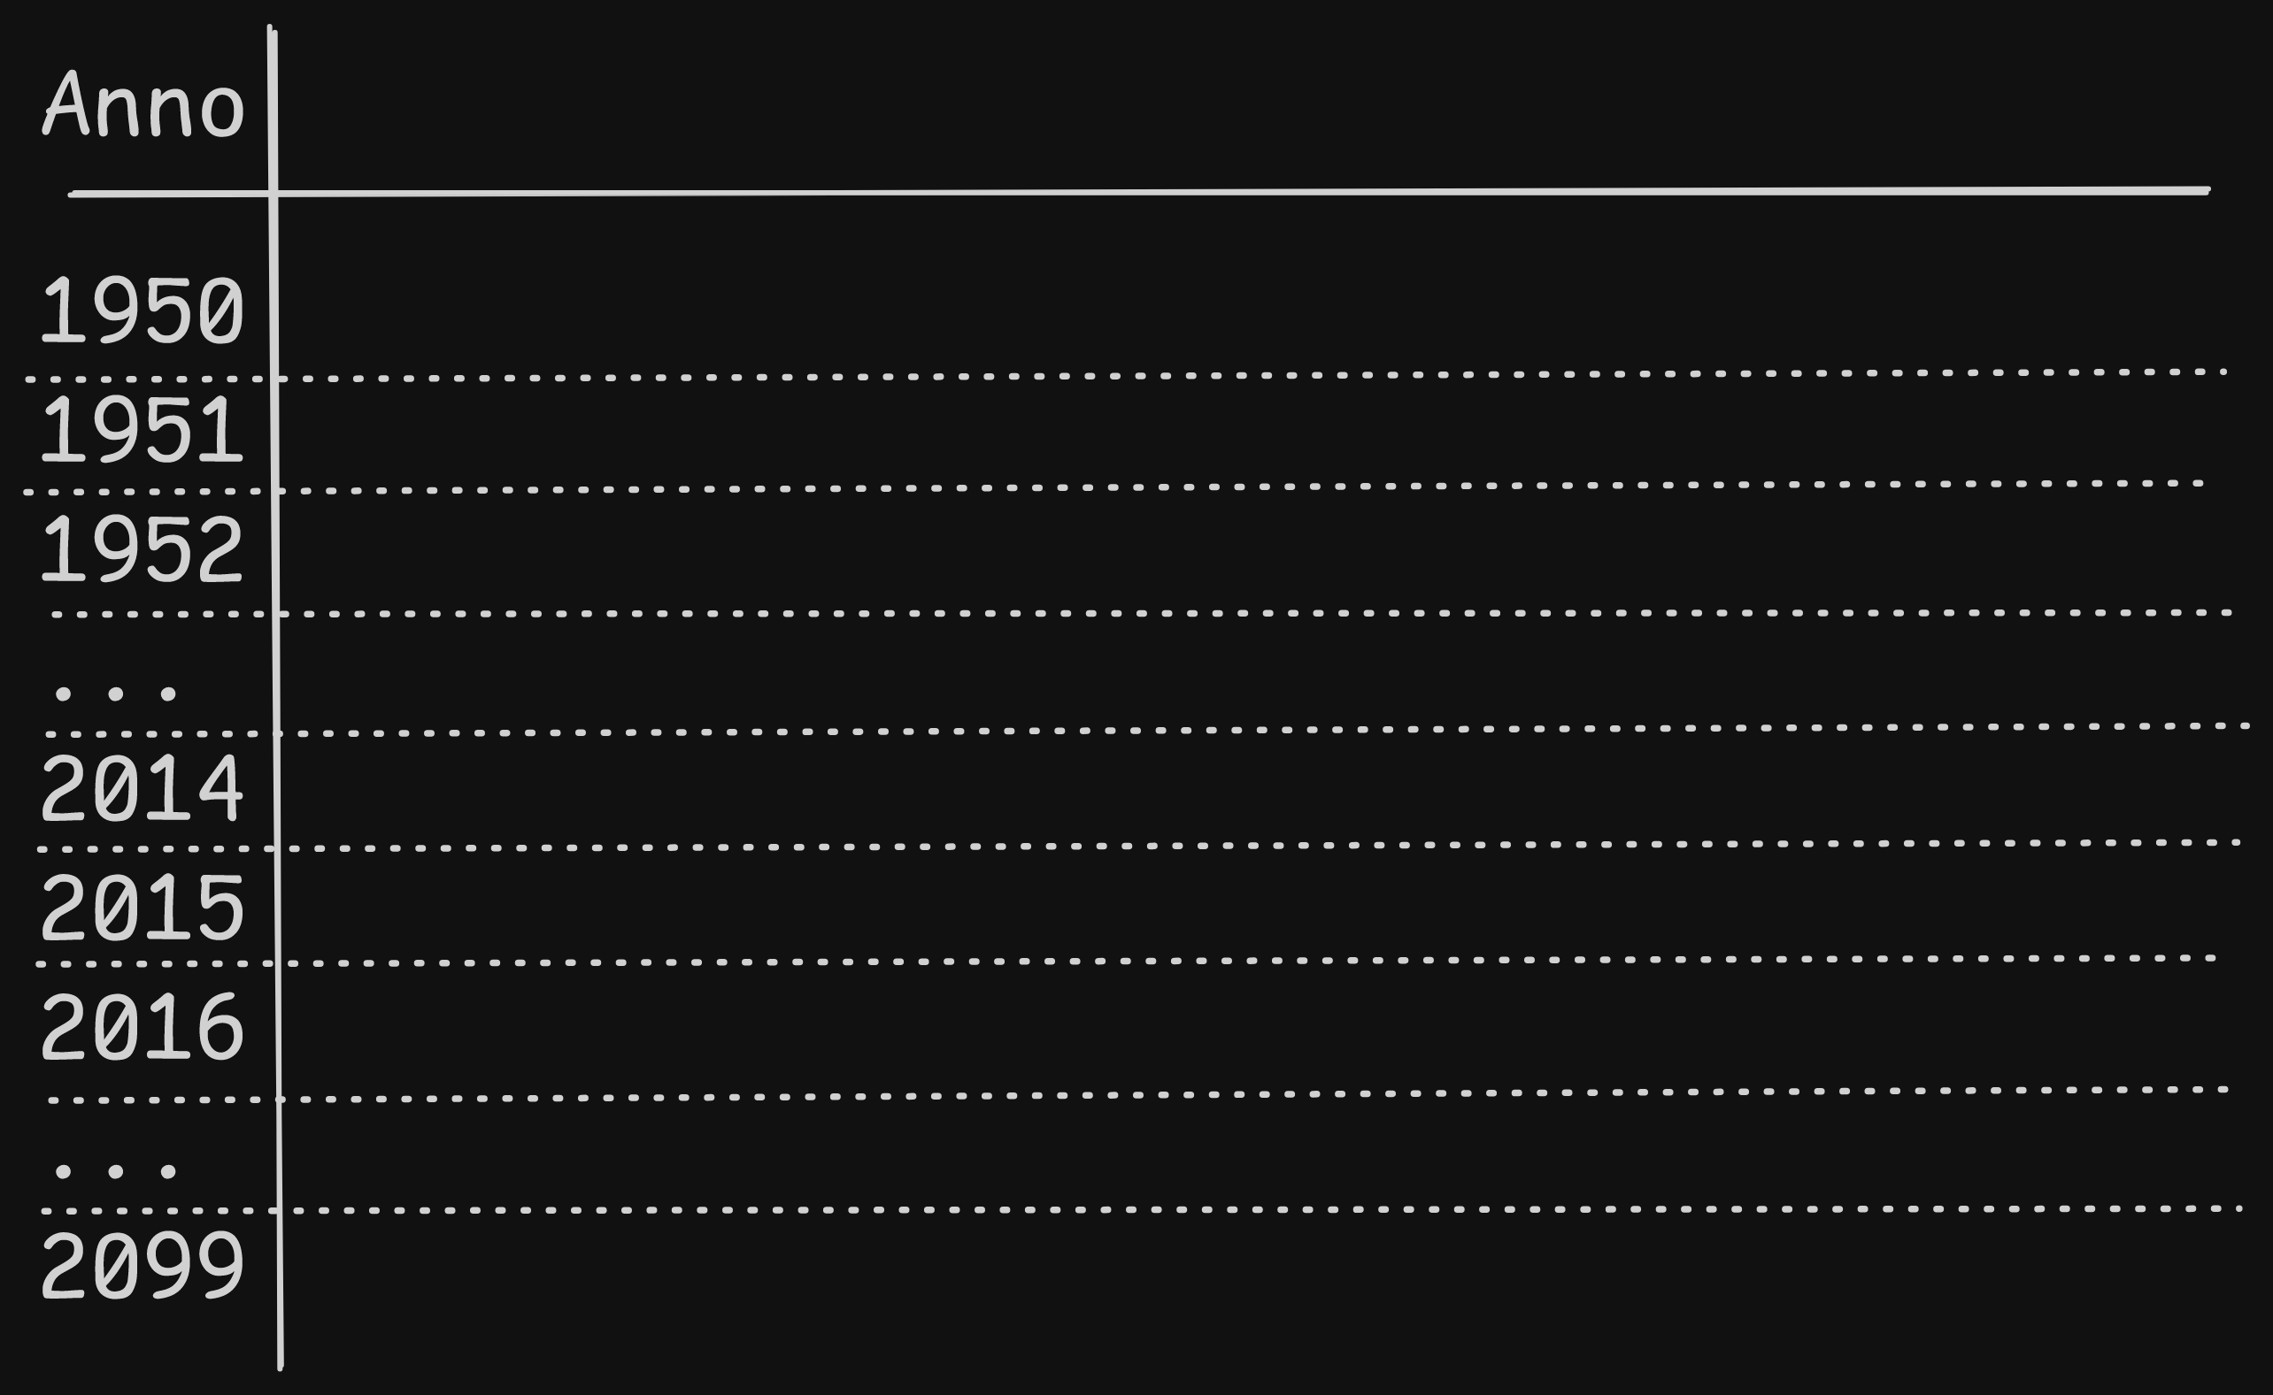

Slide 25
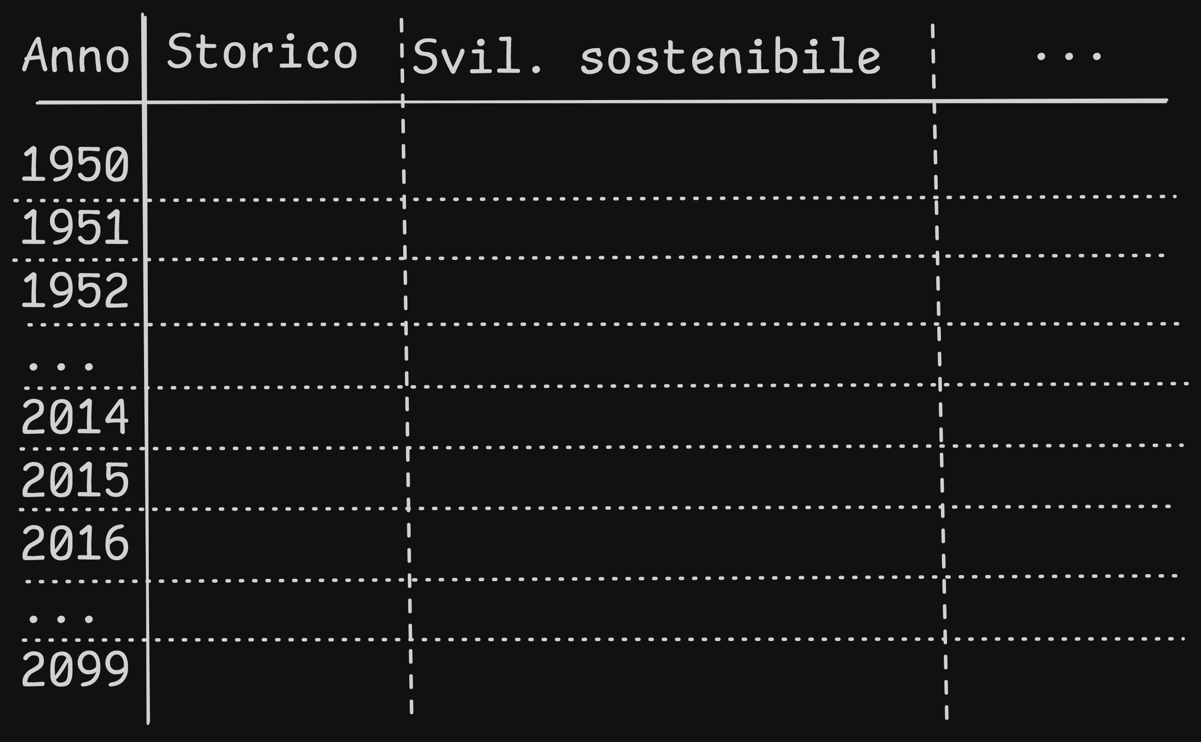

Slide 26
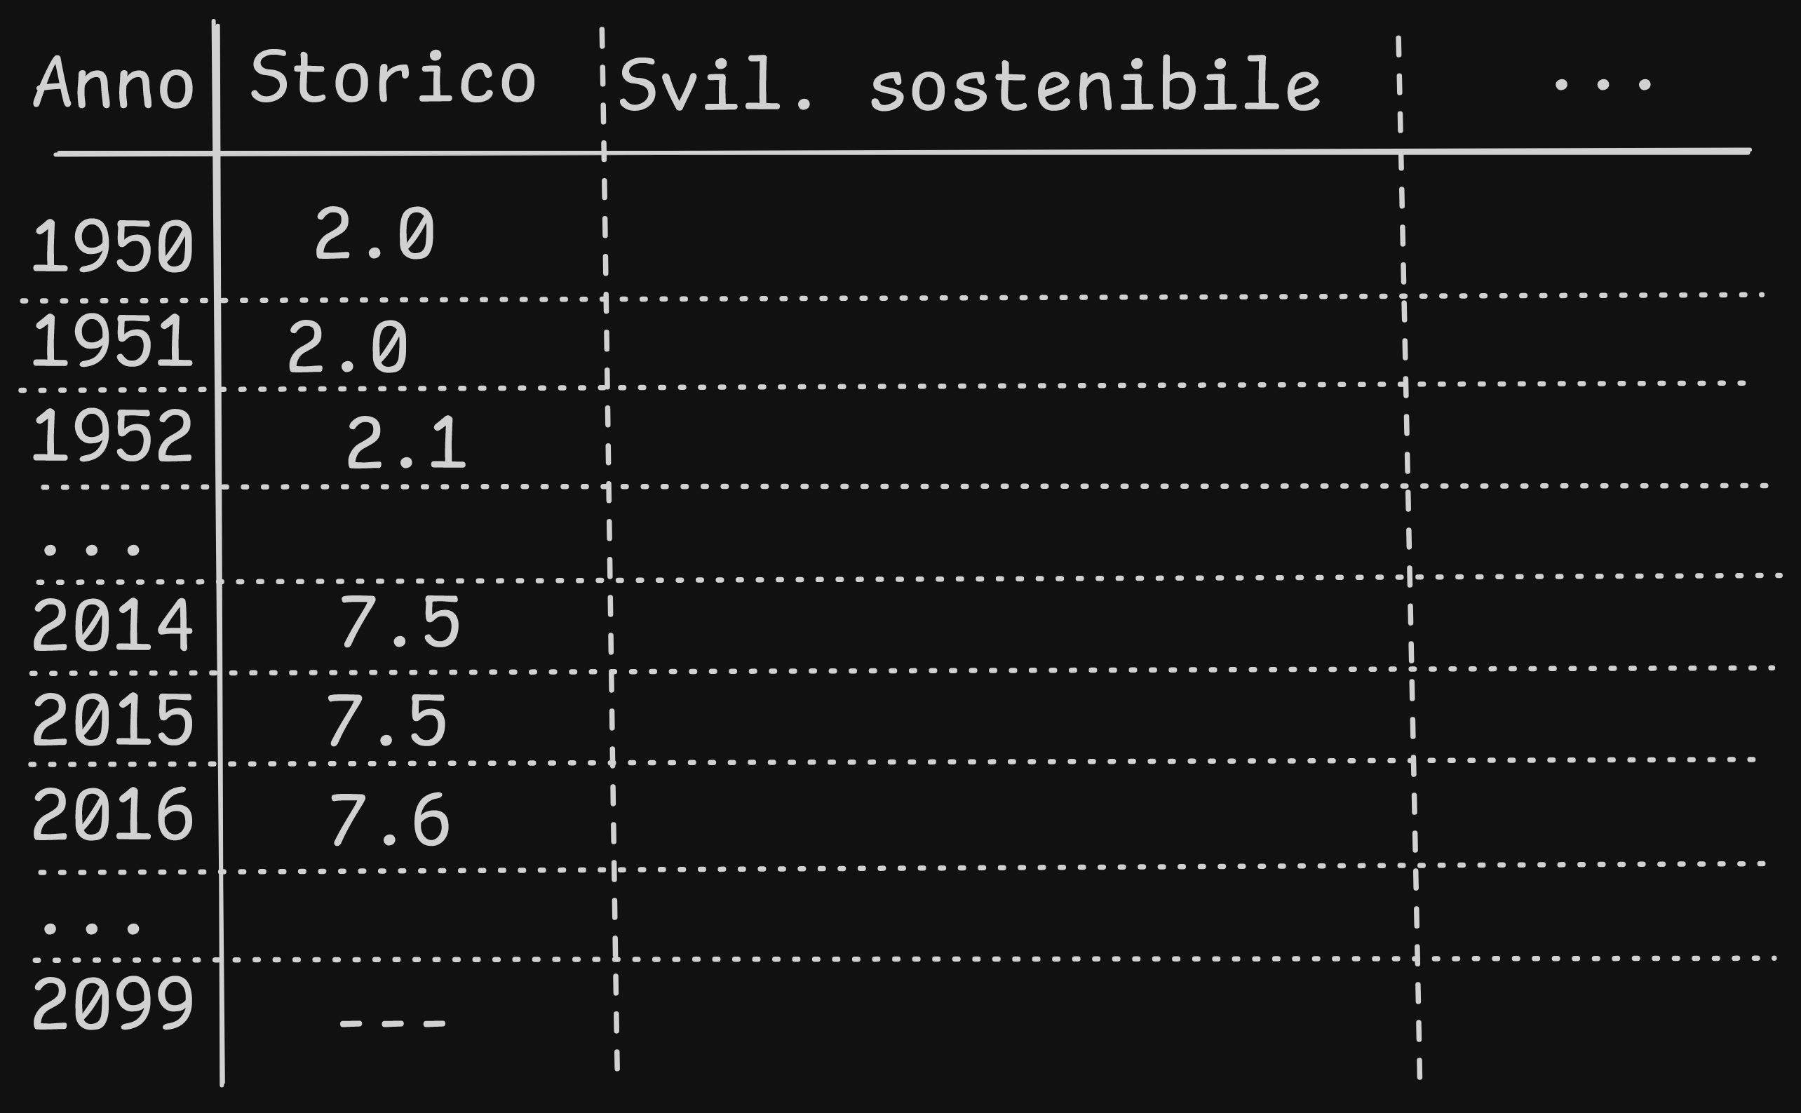

Slide 27


Slide 28
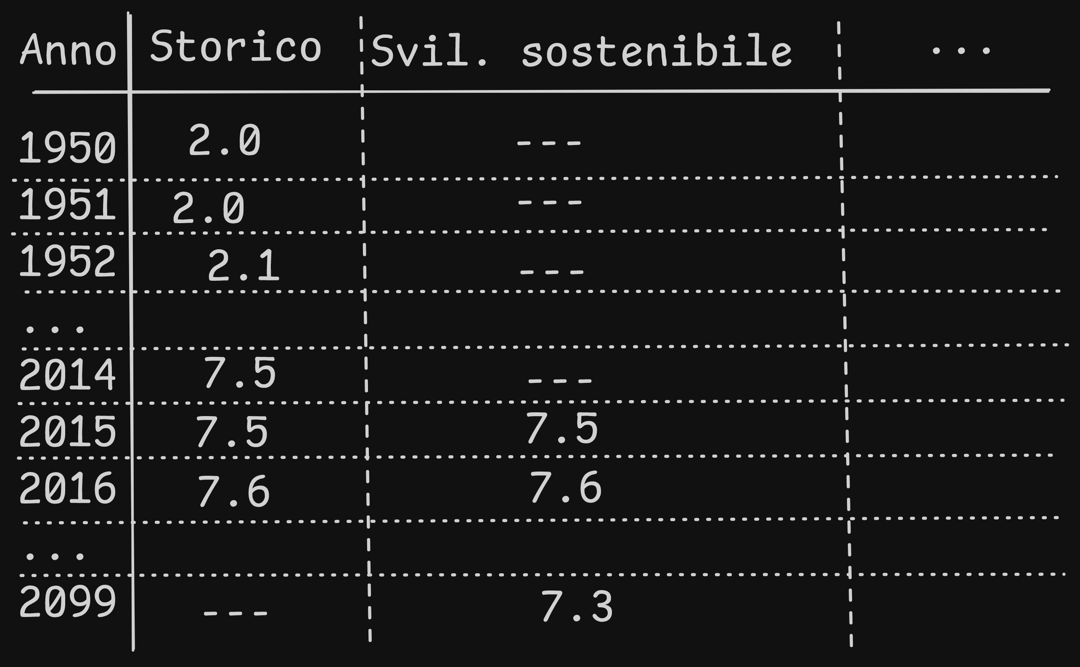

Slide 29
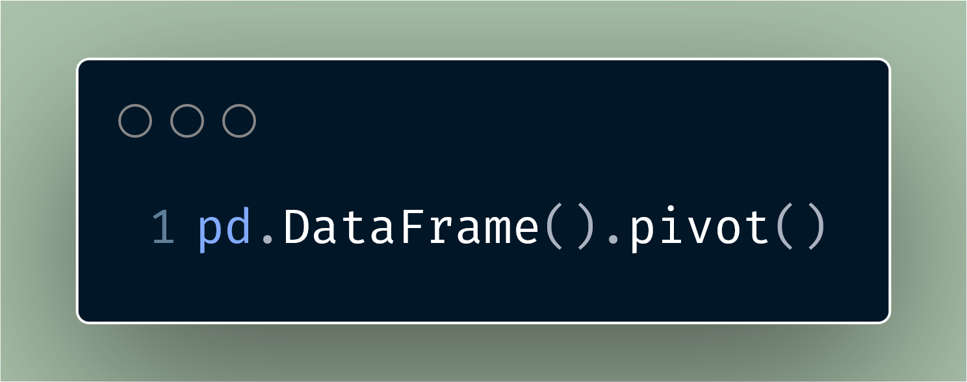

Slide 30
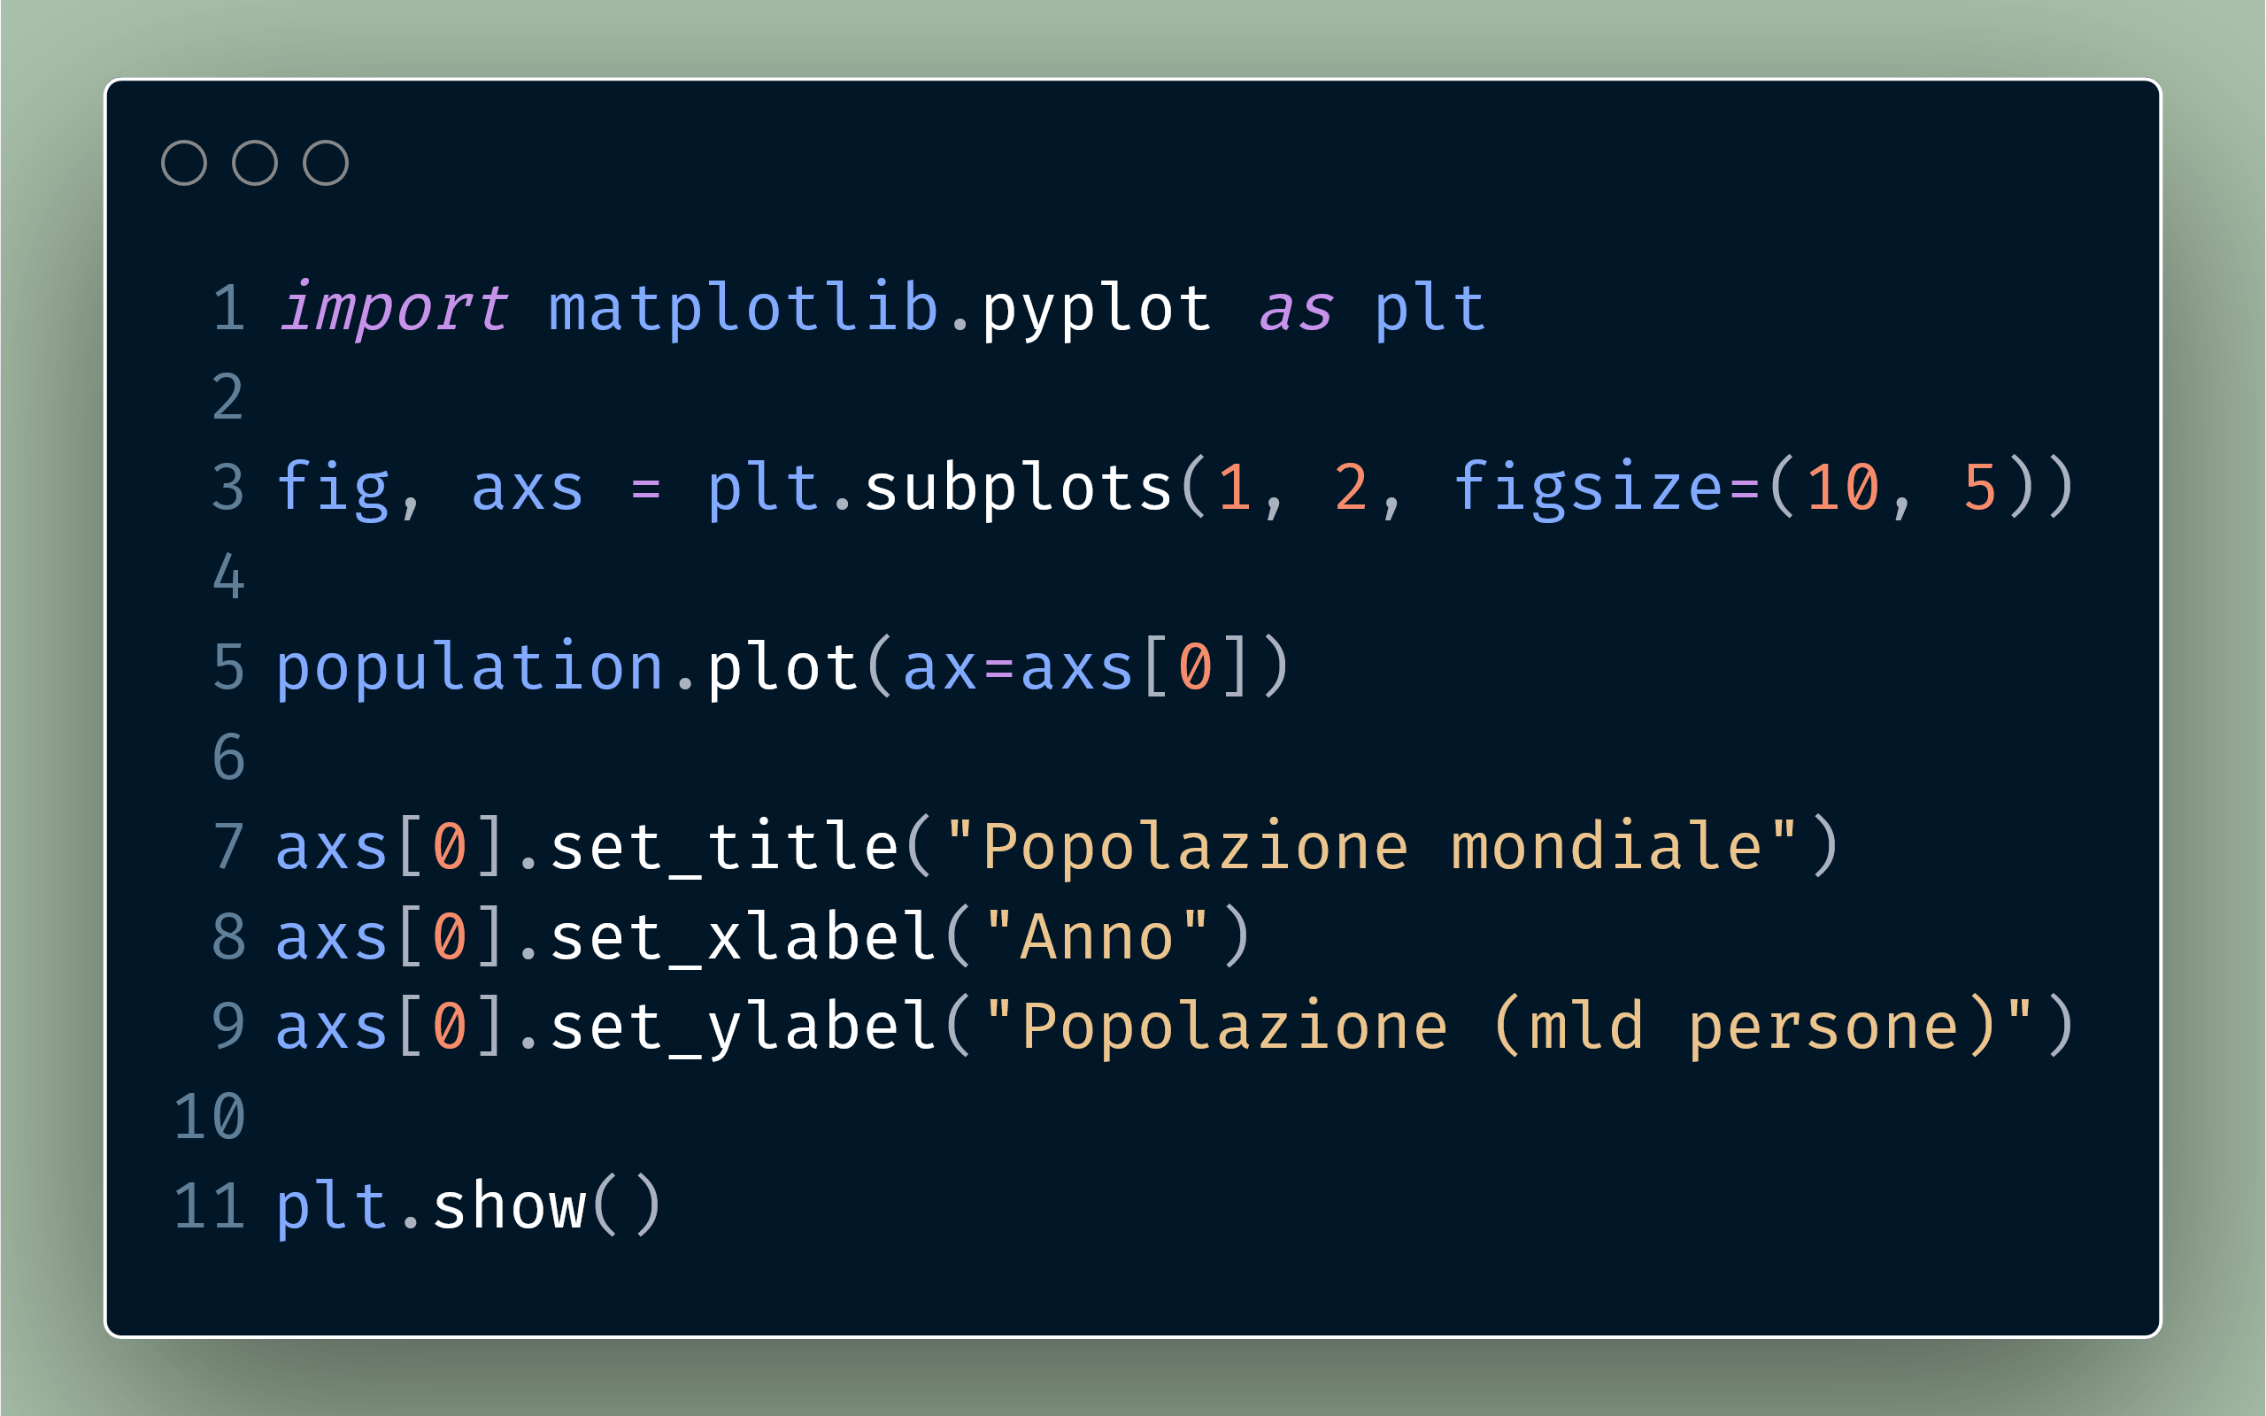
Hannah Ritchie, Pablo Rosado, and Max Roser (2023) - “CO₂ and Greenhouse Gas Emissions” Published online at OurWorldinData.org. Retrieved from: 'https://ourworldindata.org/co2-and-greenhouse-gas-emissions' [Online Resource]
© IIASA and contributing modeling teams 2024
K. Riahi et al.,

Slide 31
Hannah Ritchie, Pablo Rosado, and Max Roser (2023) - “CO₂ and Greenhouse Gas Emissions” Published online at OurWorldinData.org. Retrieved from: 'https://ourworldindata.org/co2-and-greenhouse-gas-emissions' [Online Resource]
© IIASA and contributing modeling teams 2024
K. Riahi et al.,

Slide 32
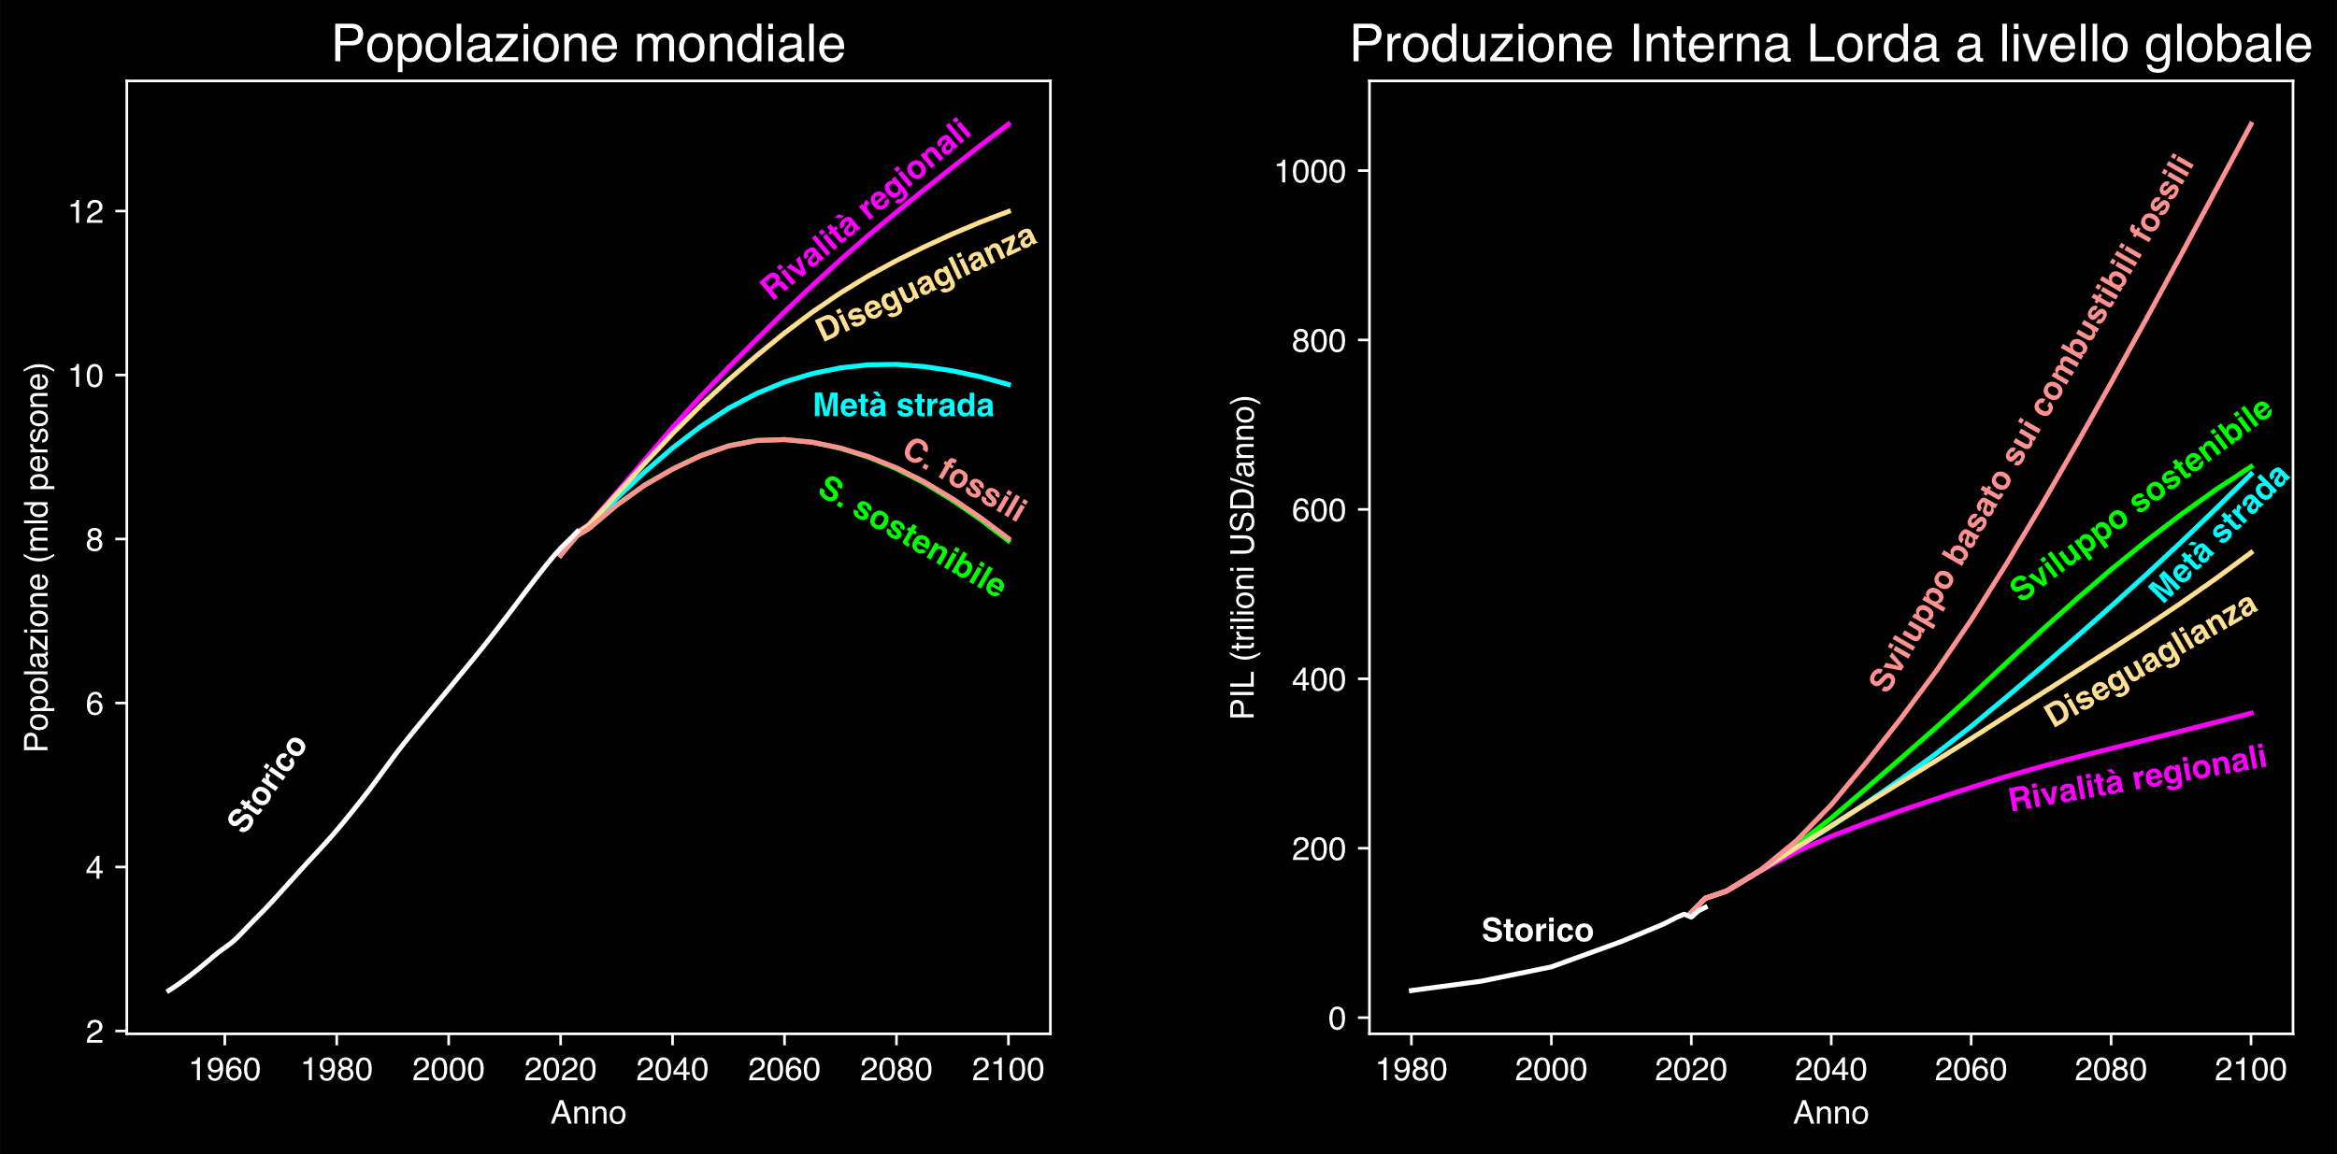
Hannah Ritchie, Pablo Rosado, and Max Roser (2023) - “CO₂ and Greenhouse Gas Emissions” Published online at OurWorldinData.org. Retrieved from: 'https://ourworldindata.org/co2-and-greenhouse-gas-emissions' [Online Resource]
© IIASA and contributing modeling teams 2024
K. Riahi et al.,

Slide 33
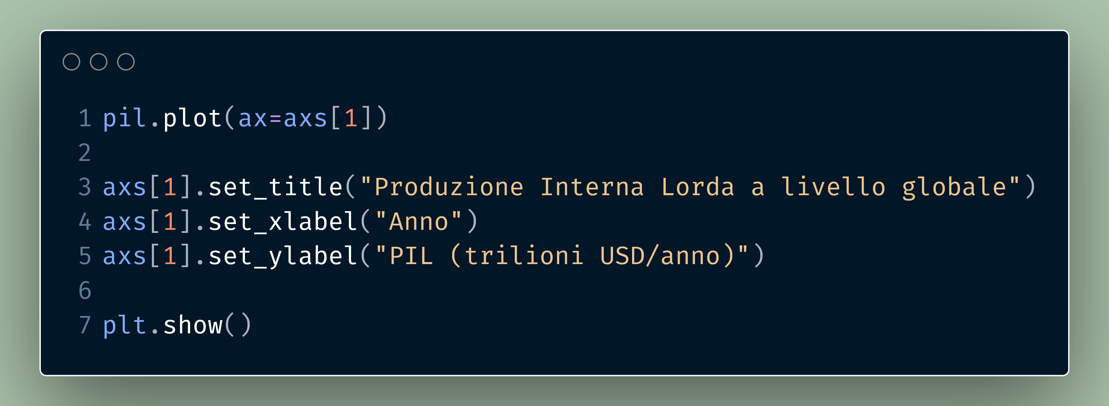
Hannah Ritchie, Pablo Rosado, and Max Roser (2023) - “CO₂ and Greenhouse Gas Emissions” Published online at OurWorldinData.org. Retrieved from: 'https://ourworldindata.org/co2-and-greenhouse-gas-emissions' [Online Resource]
© IIASA and contributing modeling teams 2024
K. Riahi et al.,

Slide 34
Hannah Ritchie, Pablo Rosado, and Max Roser (2023) - “CO₂ and Greenhouse Gas Emissions” Published online at OurWorldinData.org. Retrieved from: 'https://ourworldindata.org/co2-and-greenhouse-gas-emissions' [Online Resource]
© IIASA and contributing modeling teams 2024
K. Riahi et al.,

Slide 35
Hannah Ritchie, Pablo Rosado, and Max Roser (2023) - “CO₂ and Greenhouse Gas Emissions” Published online at OurWorldinData.org. Retrieved from: 'https://ourworldindata.org/co2-and-greenhouse-gas-emissions' [Online Resource]
© IIASA and contributing modeling teams 2024
K. Riahi et al.,

Slide 36
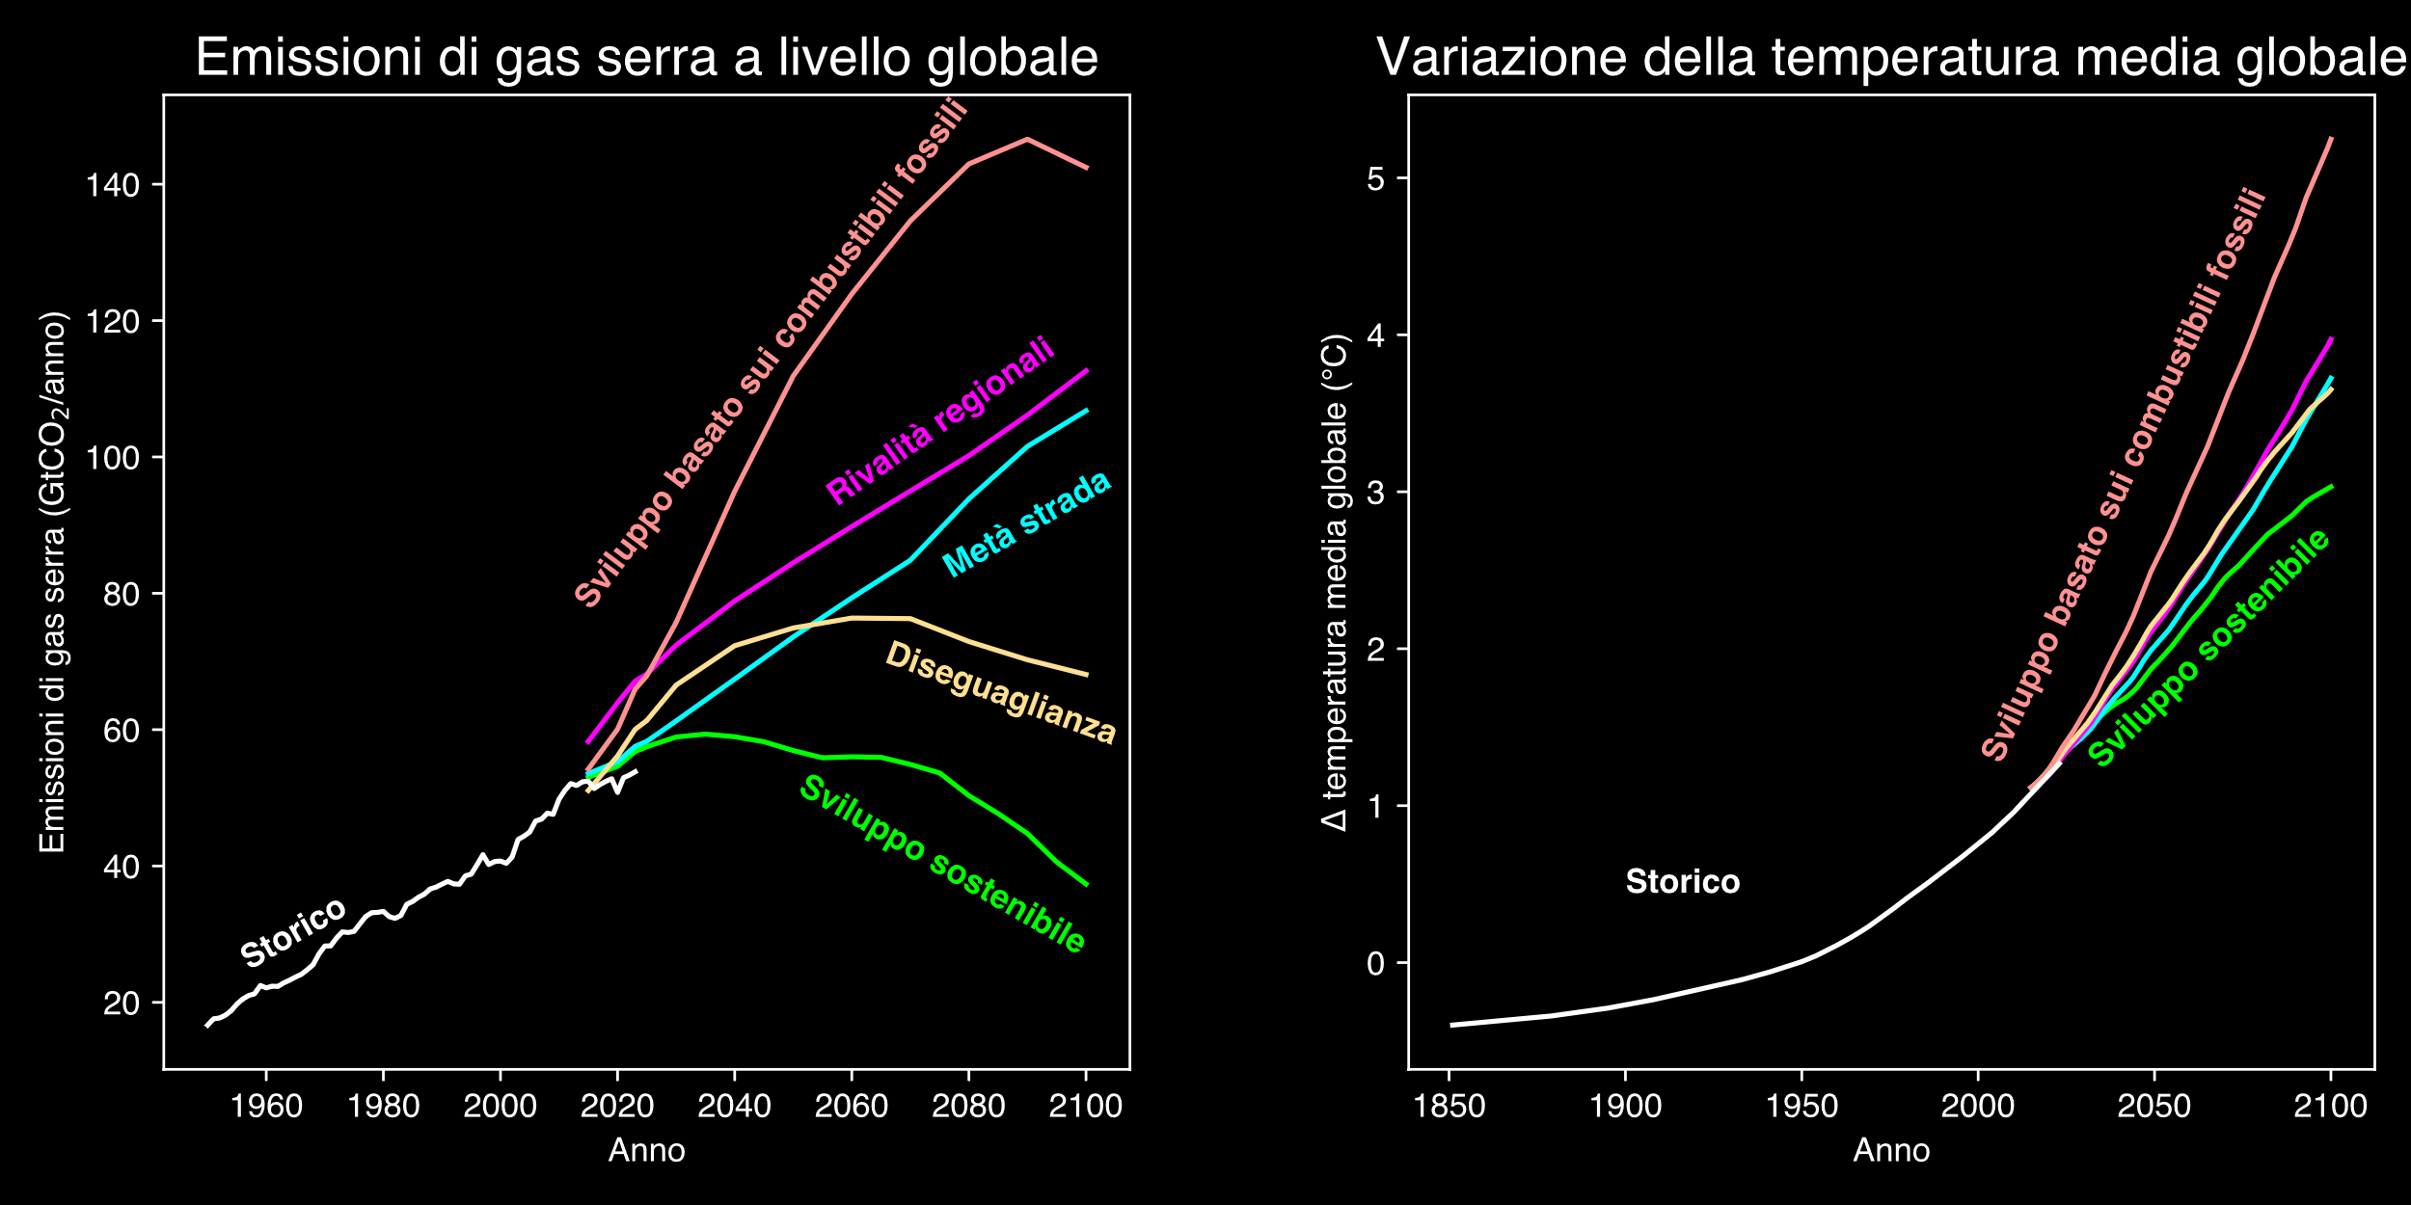
Hannah Ritchie, Pablo Rosado, and Max Roser (2023) - “CO₂ and Greenhouse Gas Emissions” Published online at OurWorldinData.org. Retrieved from: 'https://ourworldindata.org/co2-and-greenhouse-gas-emissions' [Online Resource]
© IIASA and contributing modeling teams 2024
K. Riahi et al.,

Slide 37
Hannah Ritchie, Pablo Rosado, and Max Roser (2023) - “CO₂ and Greenhouse Gas Emissions” Published online at OurWorldinData.org. Retrieved from: 'https://ourworldindata.org/co2-and-greenhouse-gas-emissions' [Online Resource]
© IIASA and contributing modeling teams 2024
K. Riahi et al.,

Slide 38
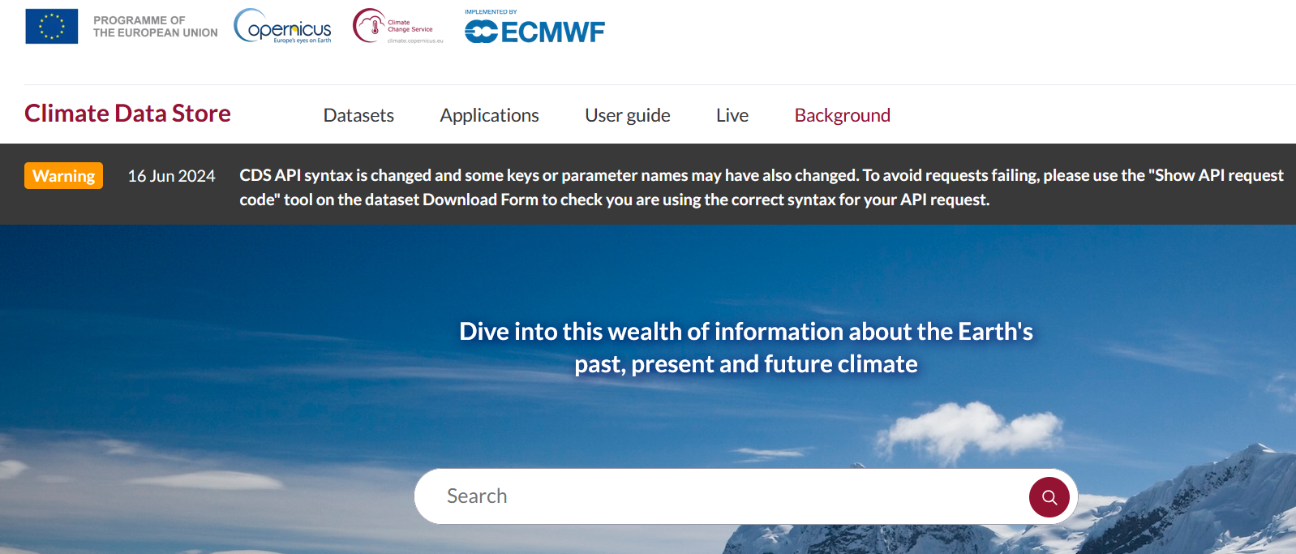
https://cds.climate.copernicus.eu/

Slide 39
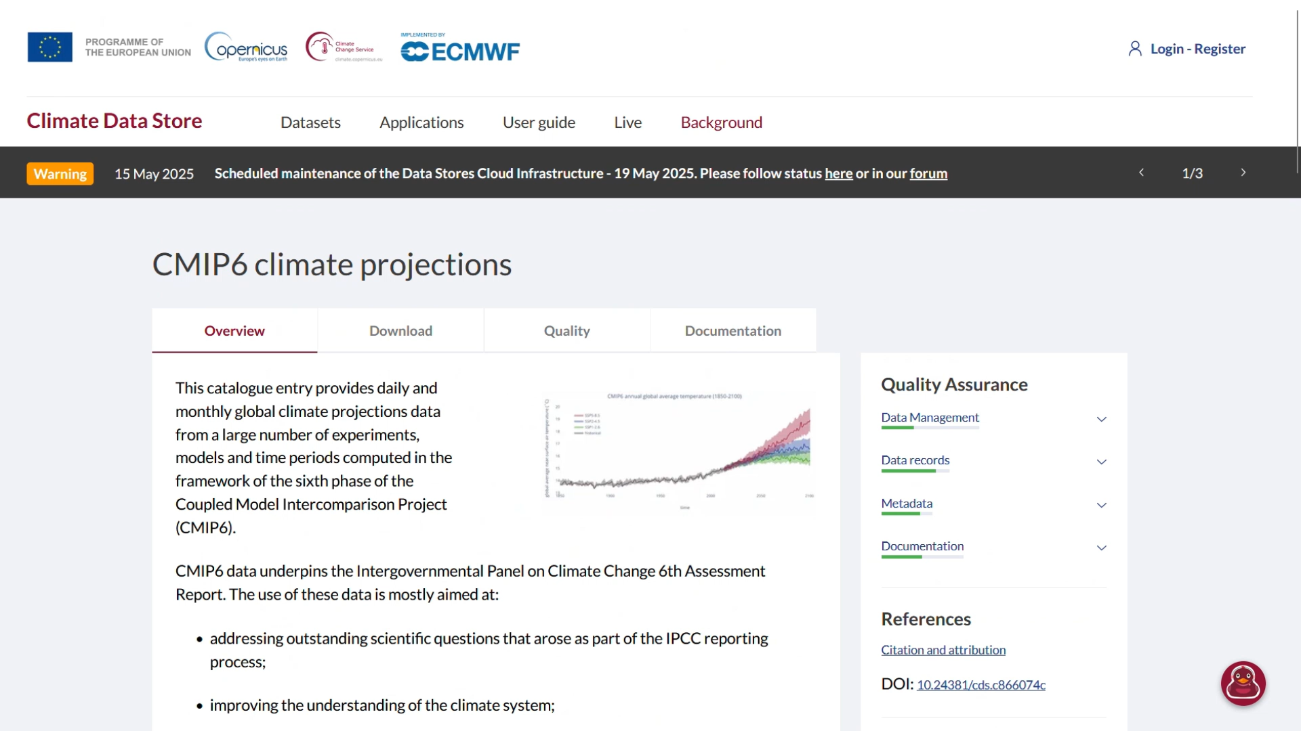

Slide 40
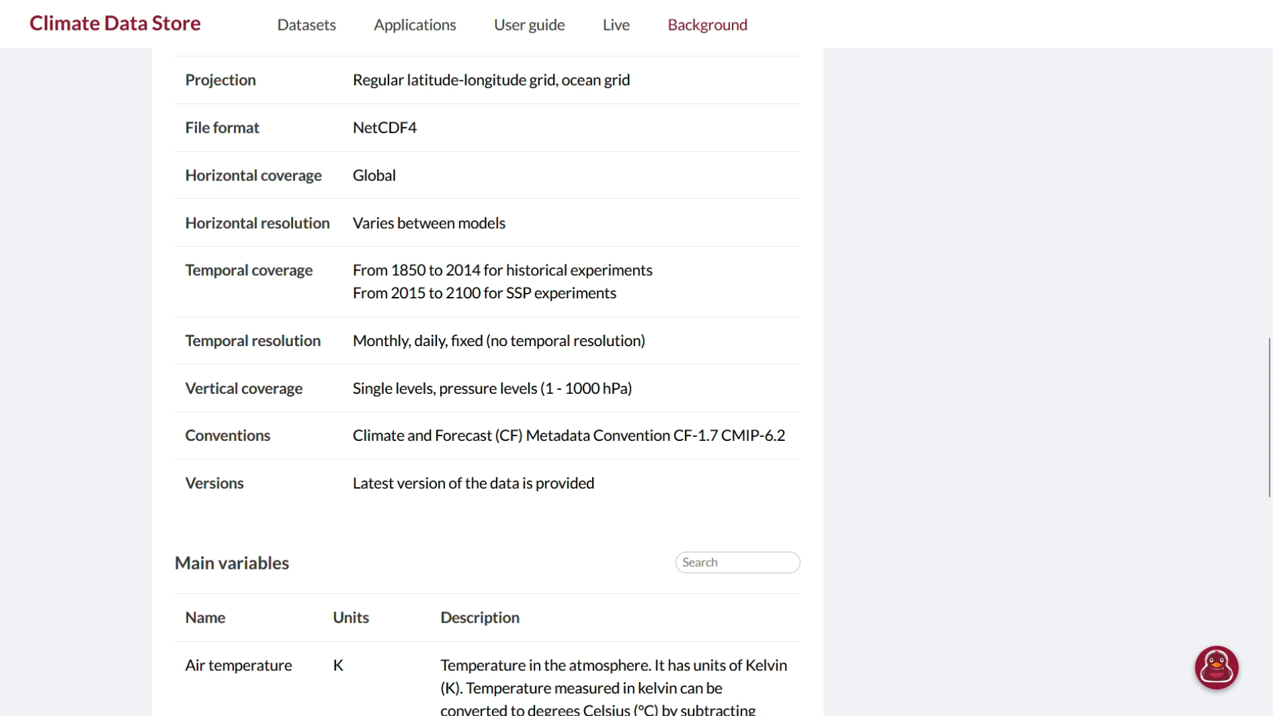

Slide 41
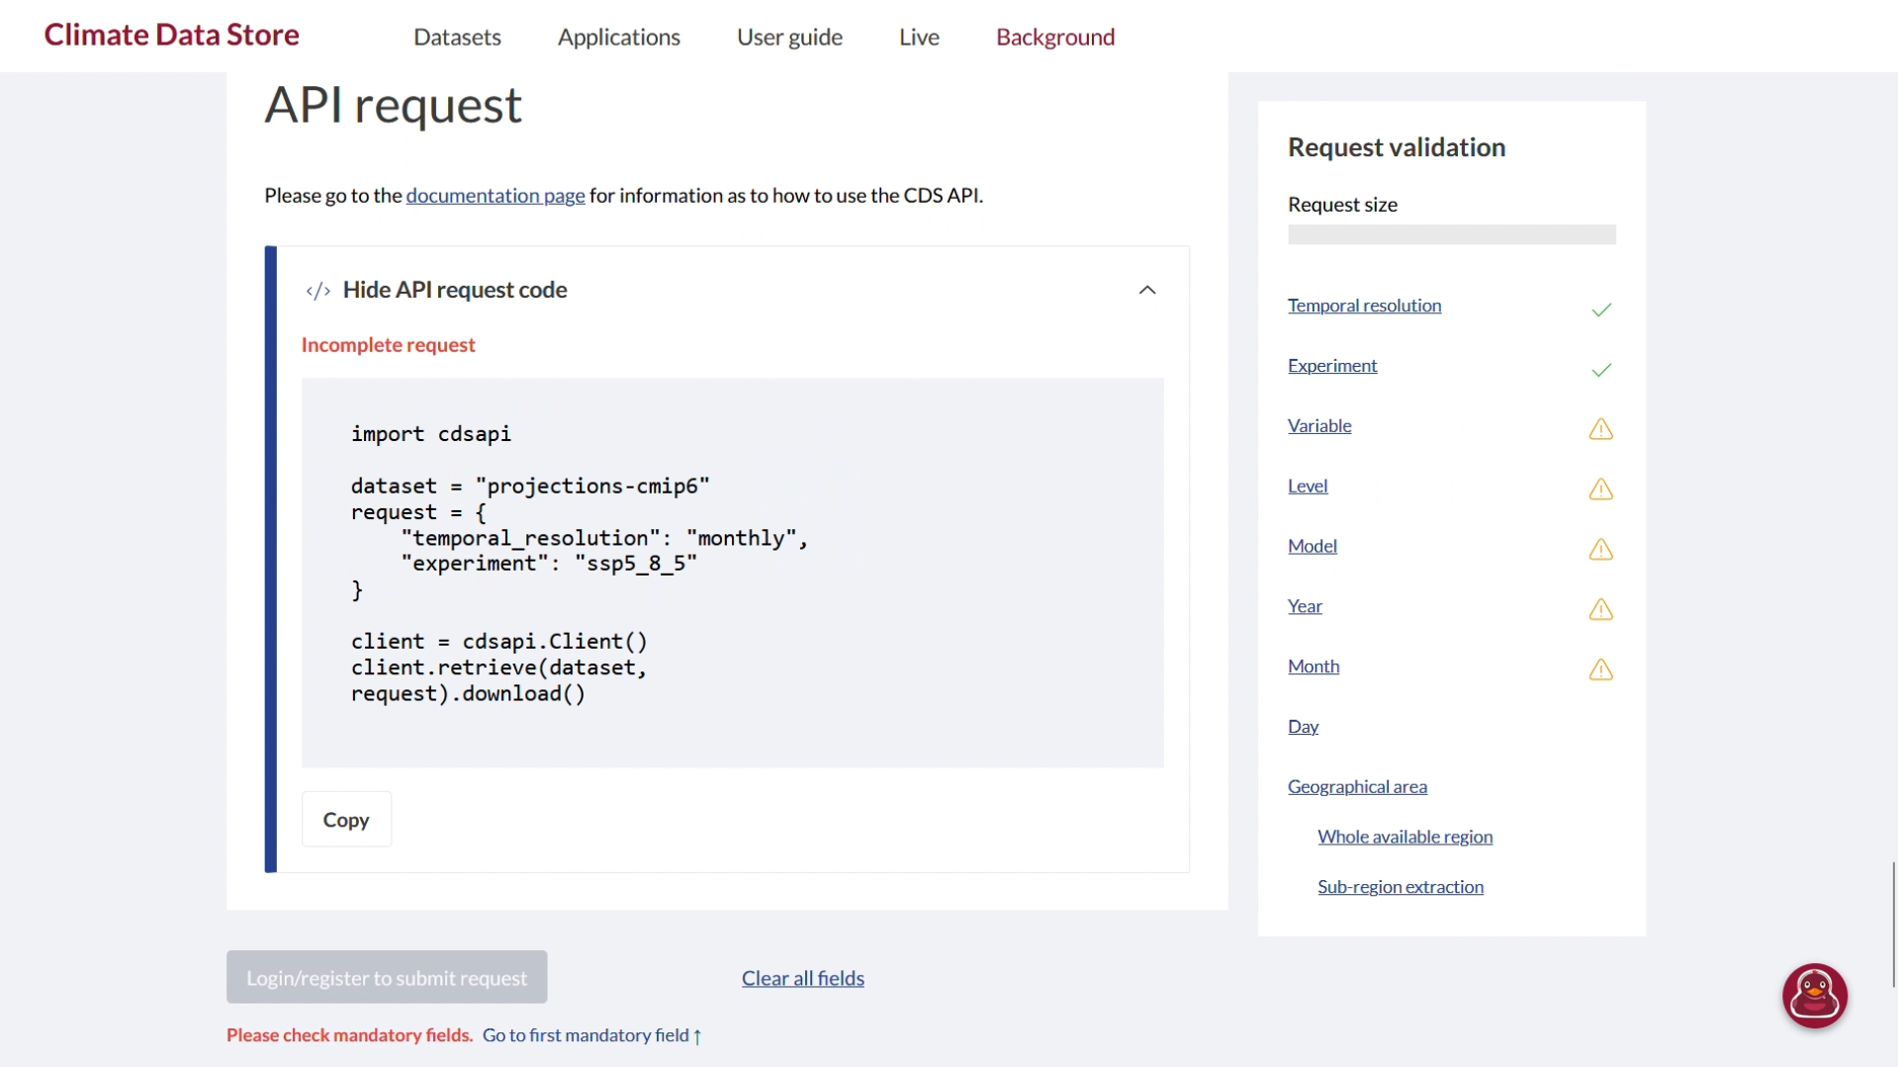

Slide 42
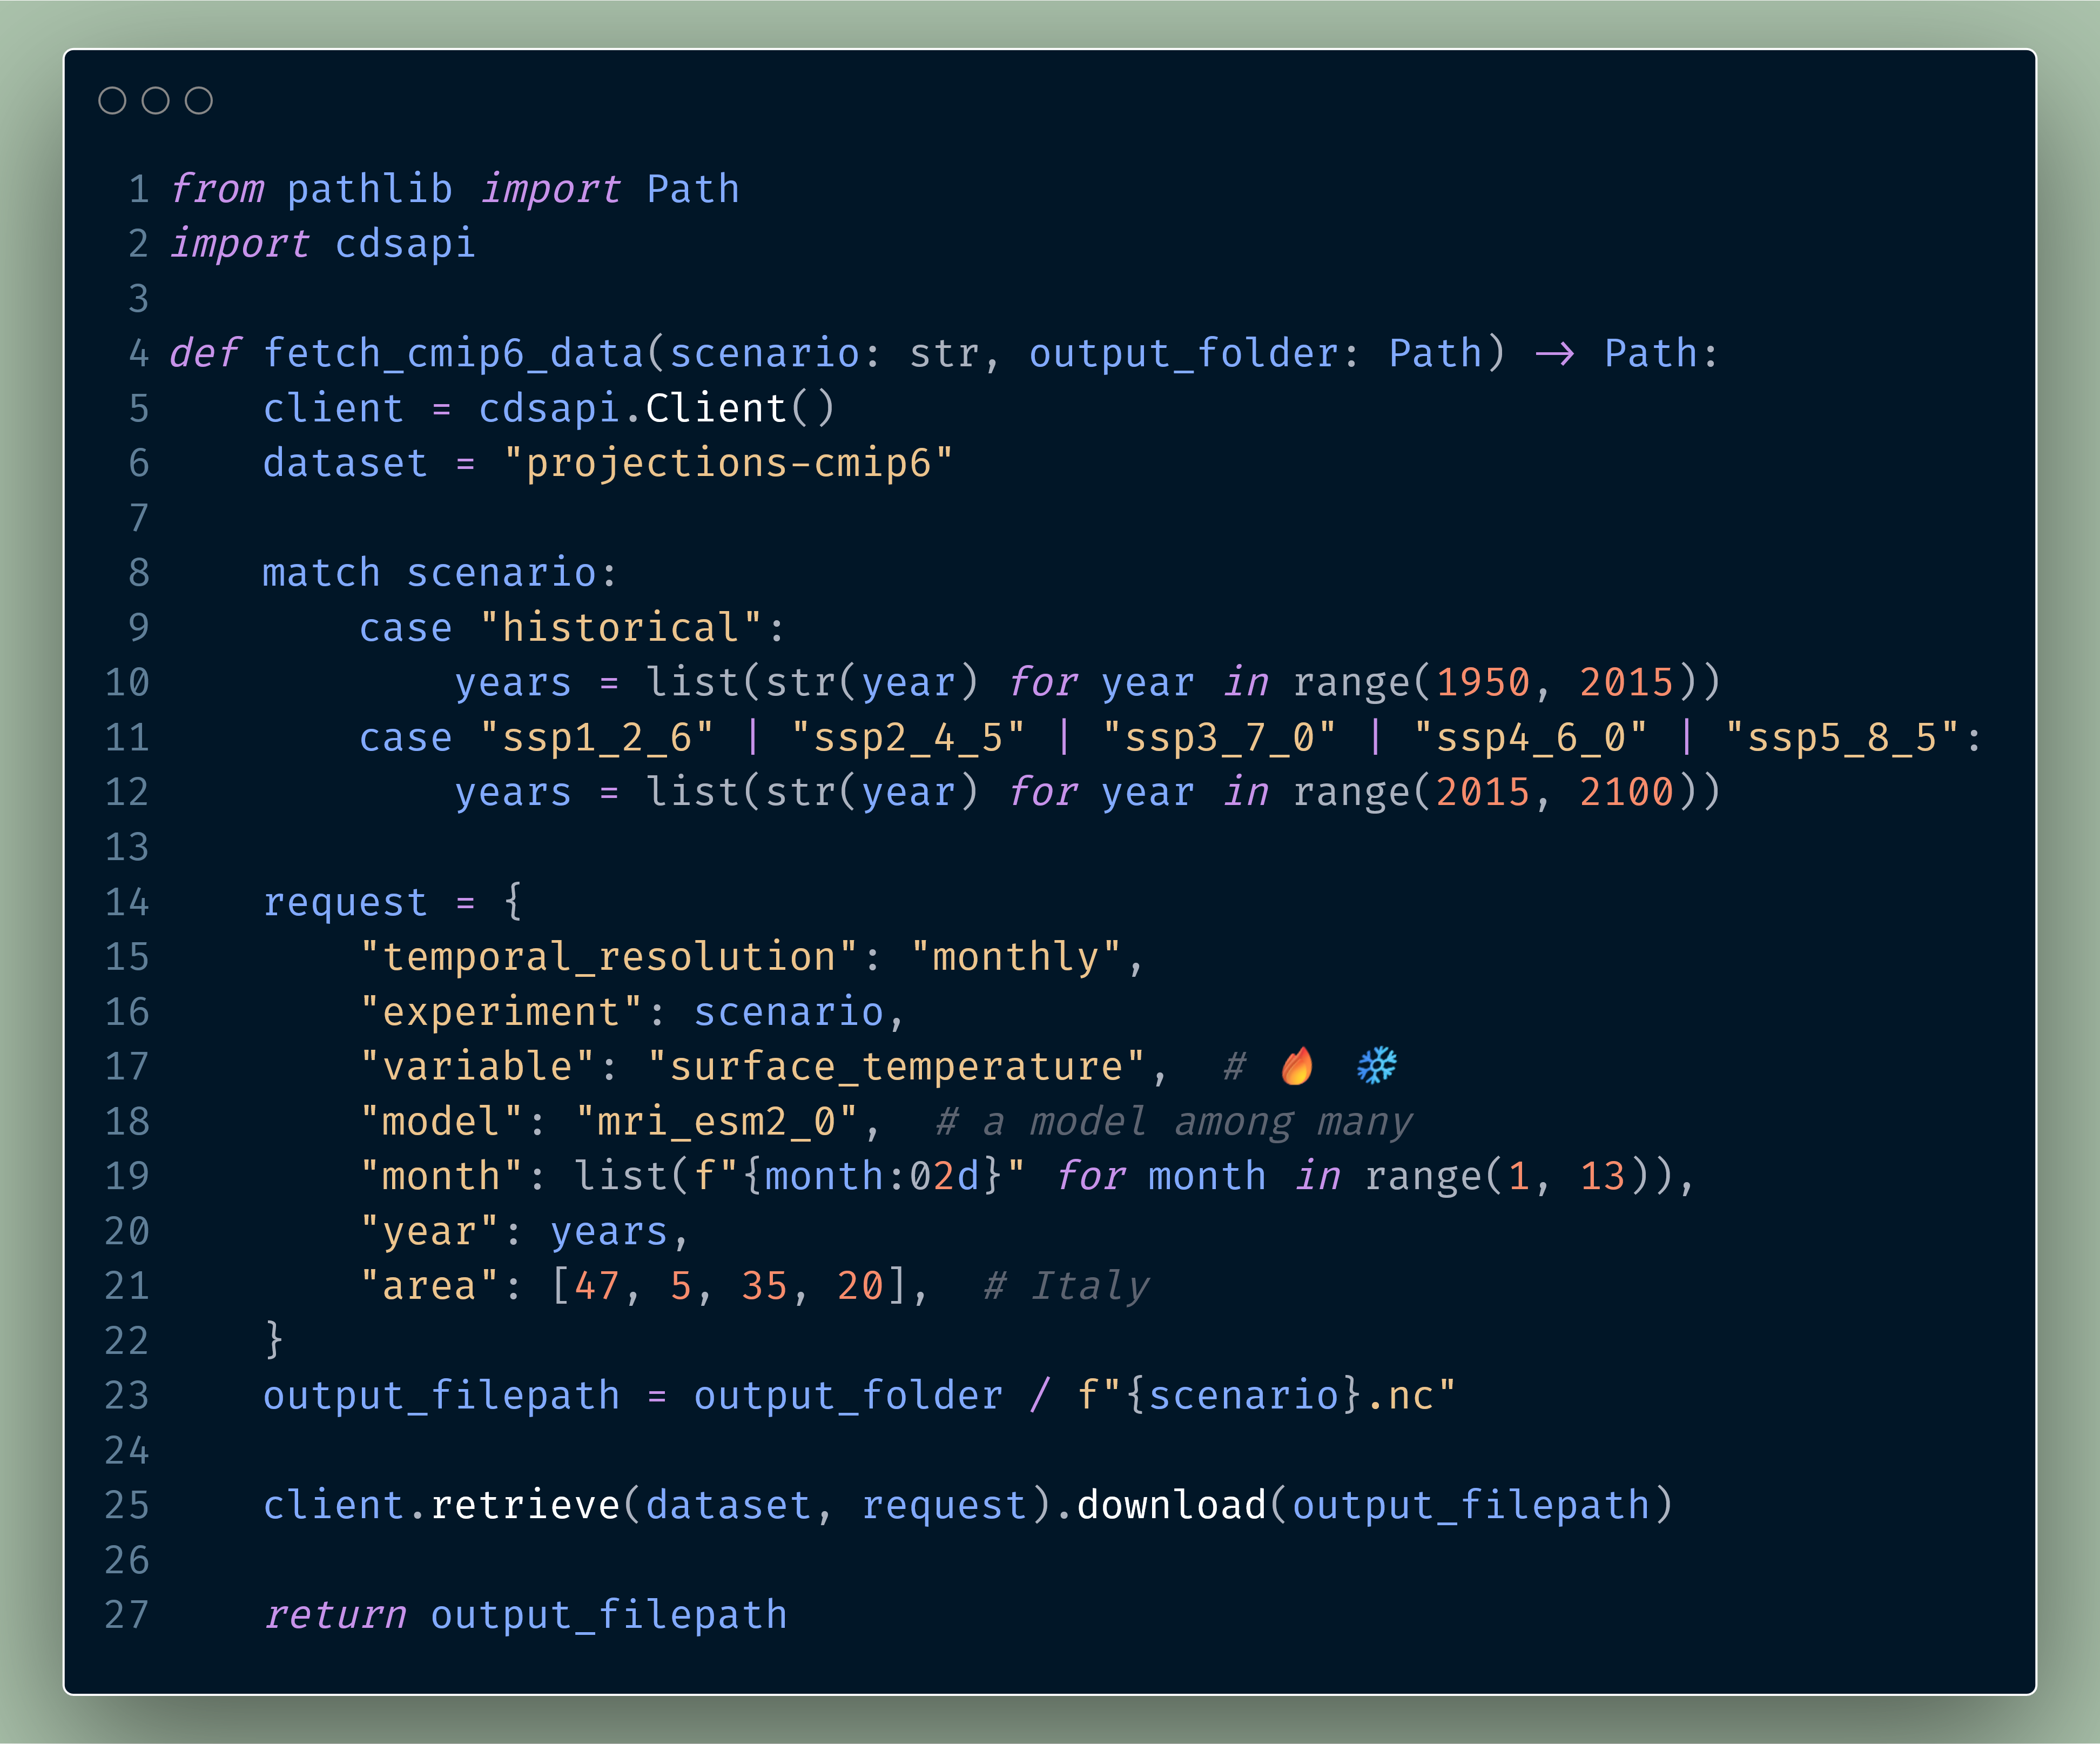

Slide 47
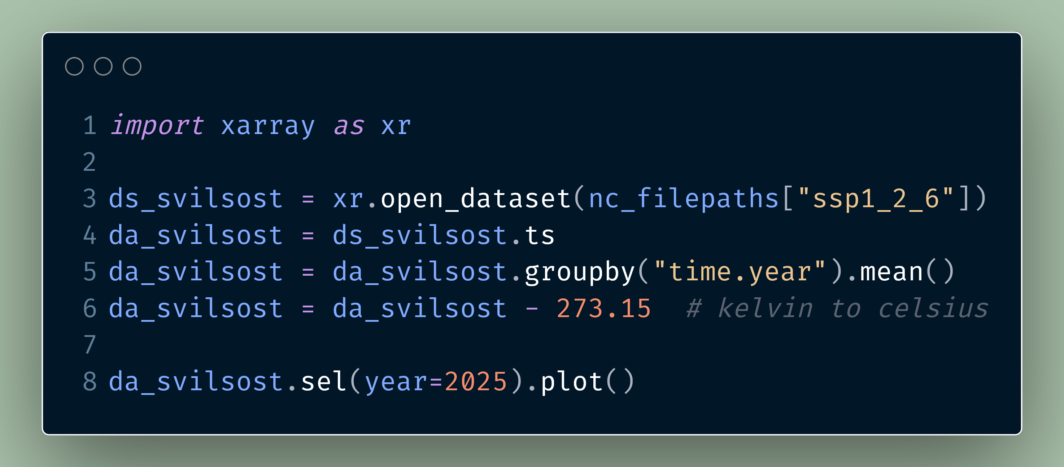

Slide 48
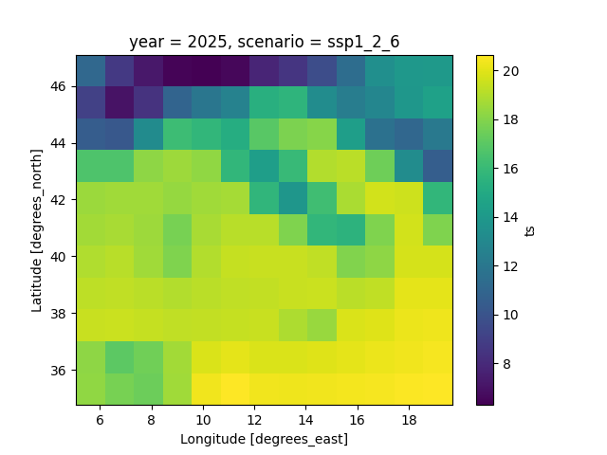

Slide 49
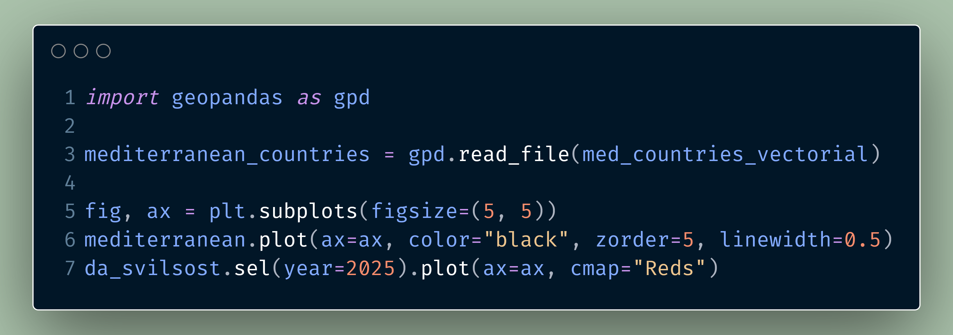

Slide 50
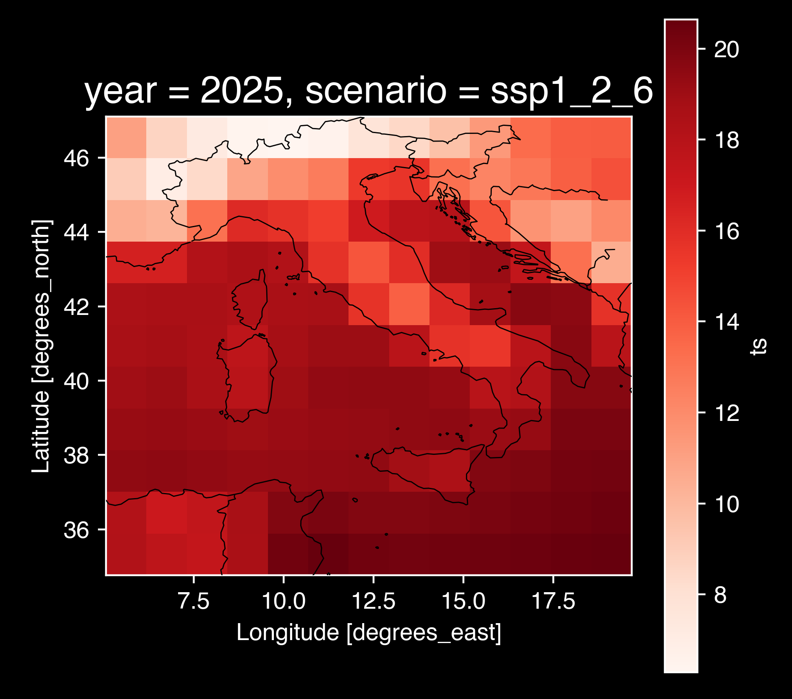

Slide 51
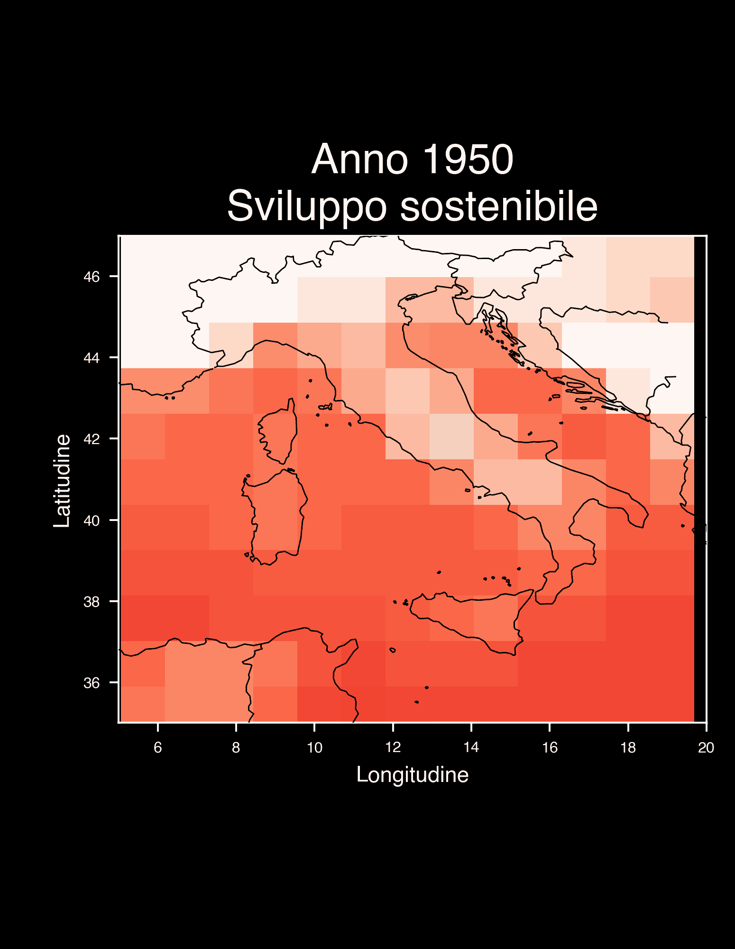
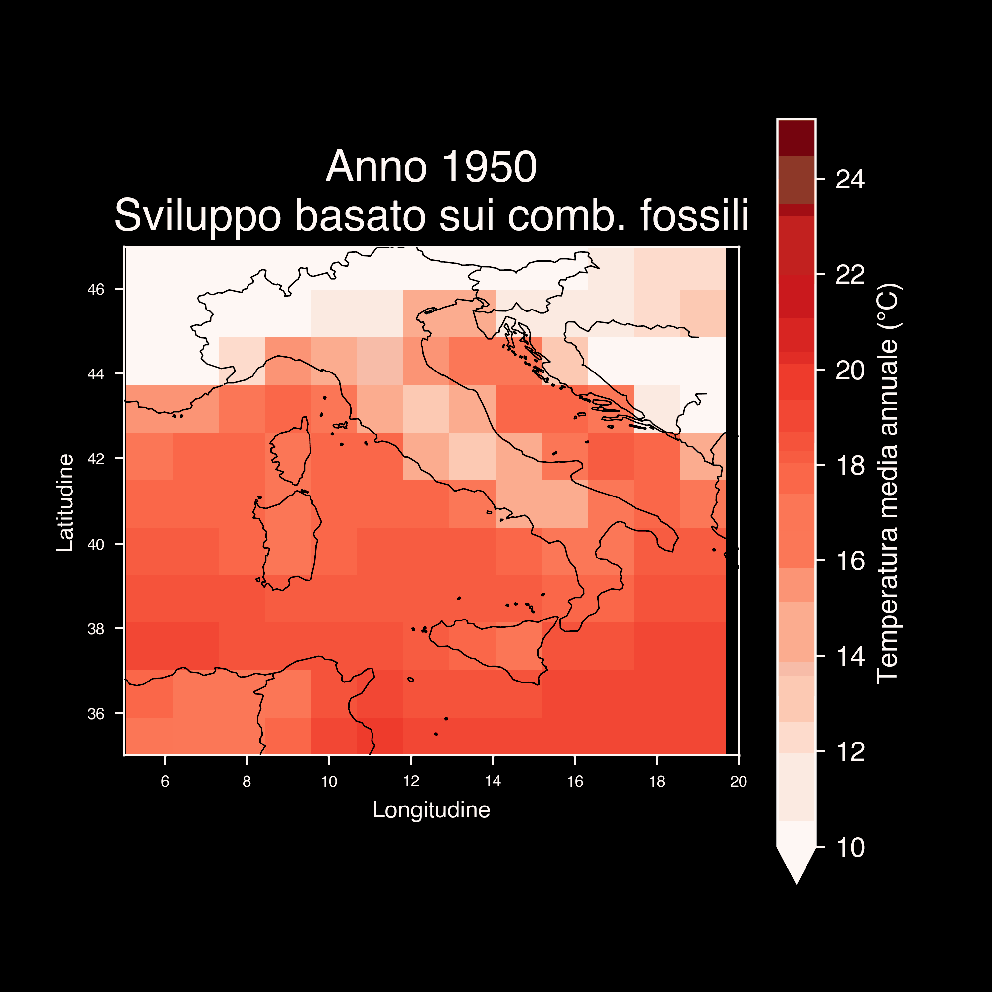

Slide 52
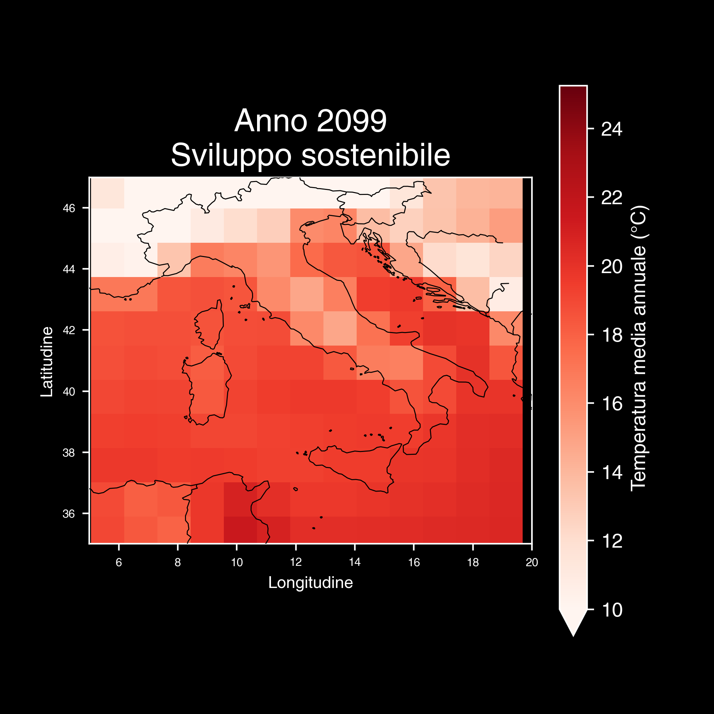
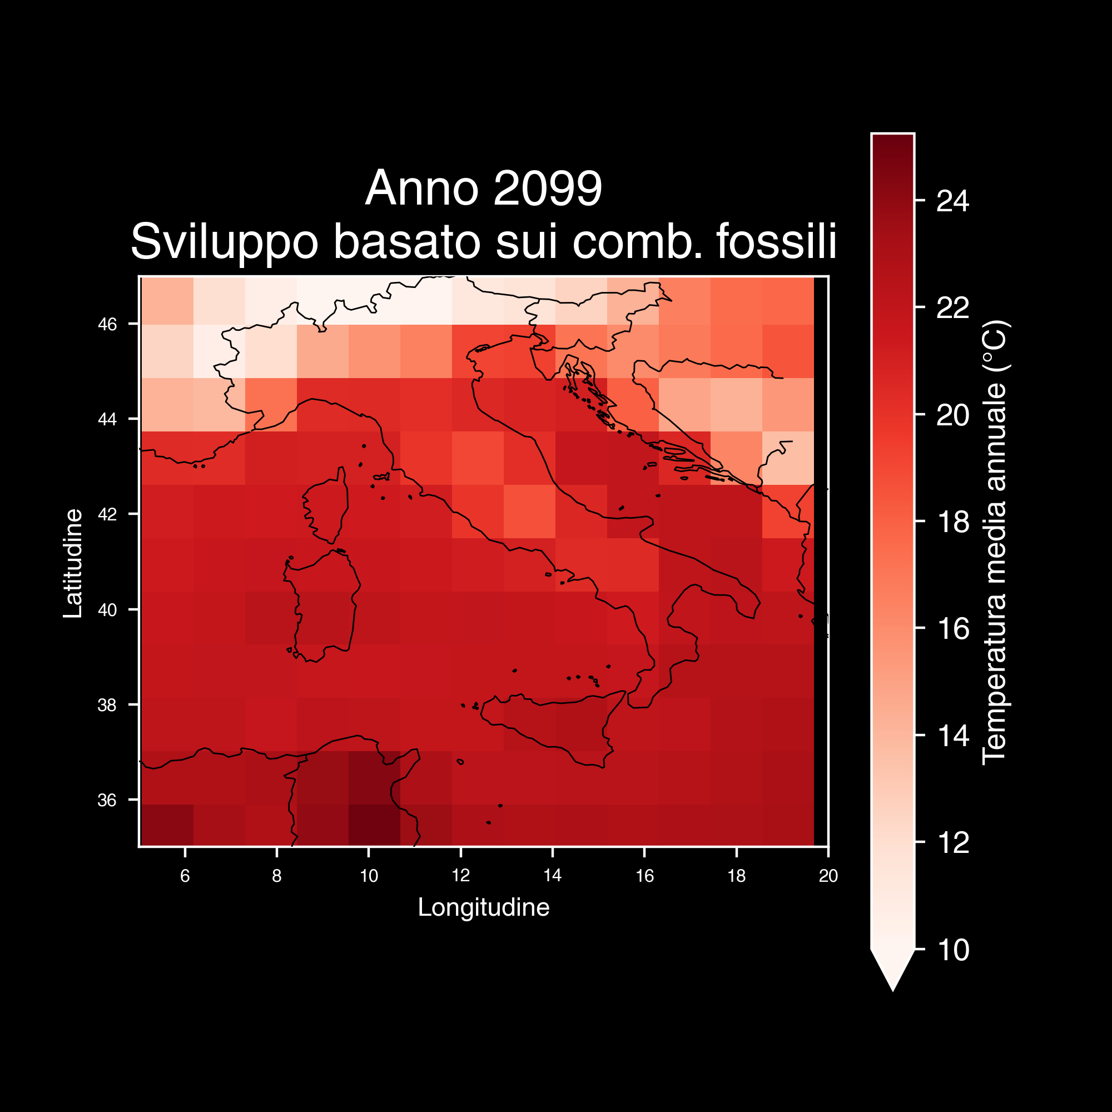

Slide 53
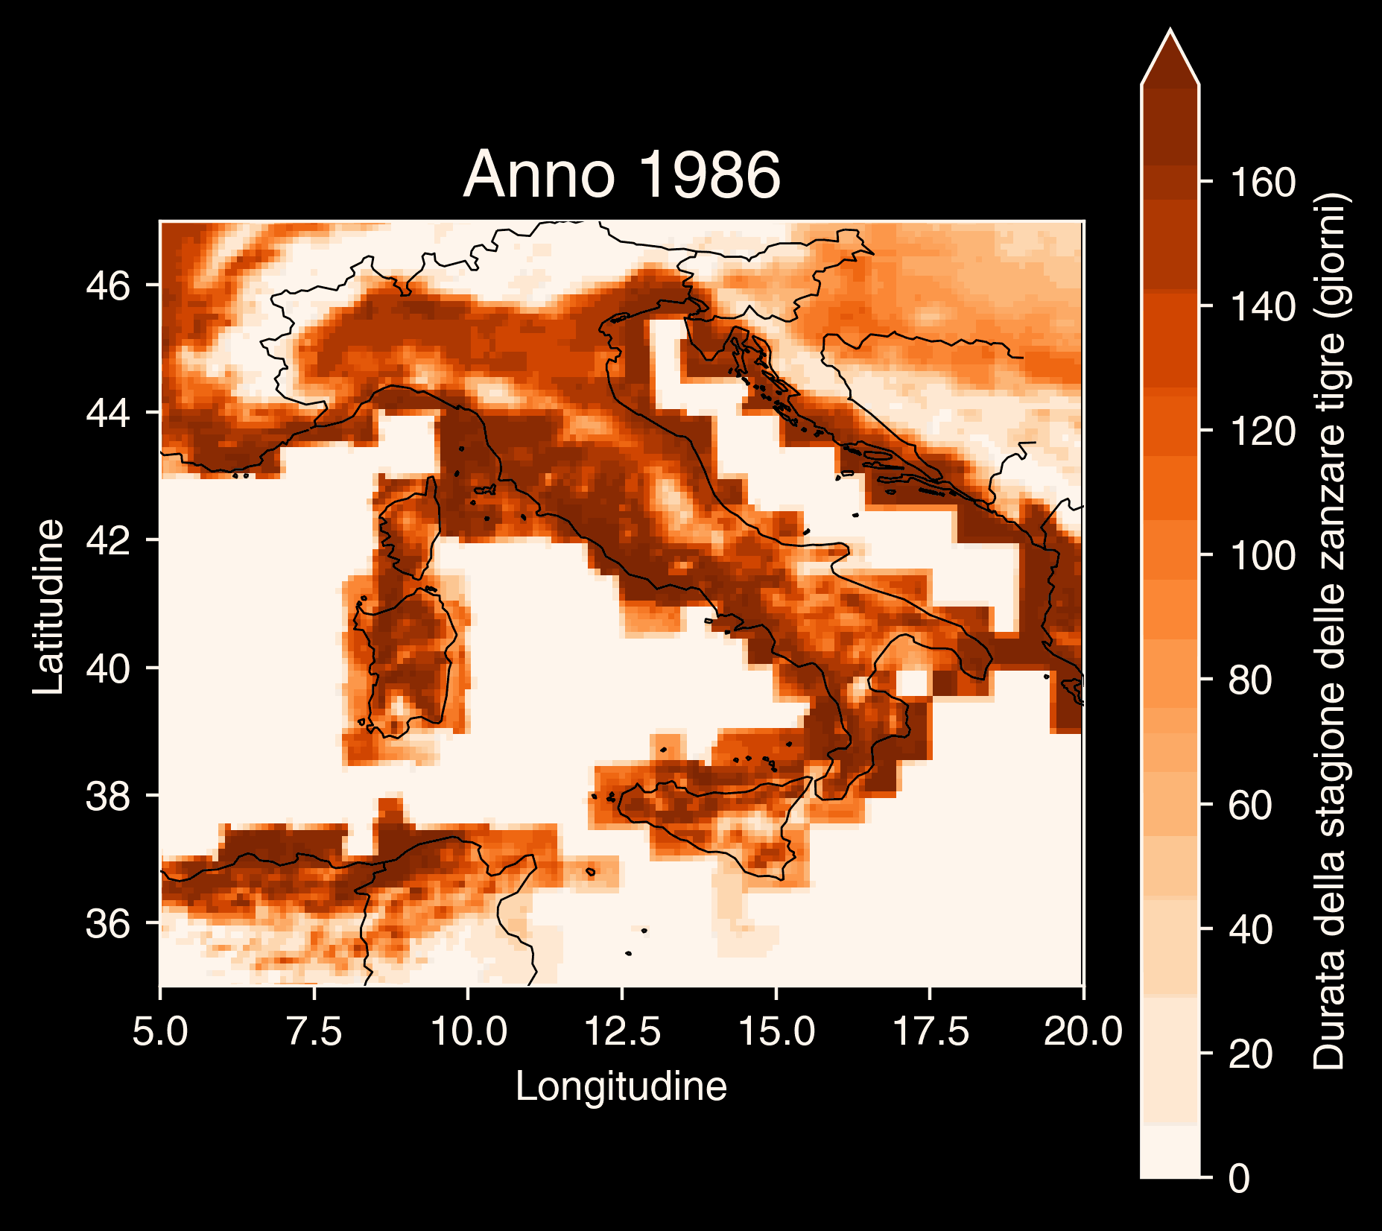
Copernicus Climate Change Service, Climate Data Store, (2019): Climatic suitability for the presence and seasonal activity of the Aedes albopictus mosquito for Europe derived from climate projections. Copernicus Climate Change Service (C3S) Climate Data Store (CDS). DOI: 10.24381/cds.d08ed09a

Slide 54

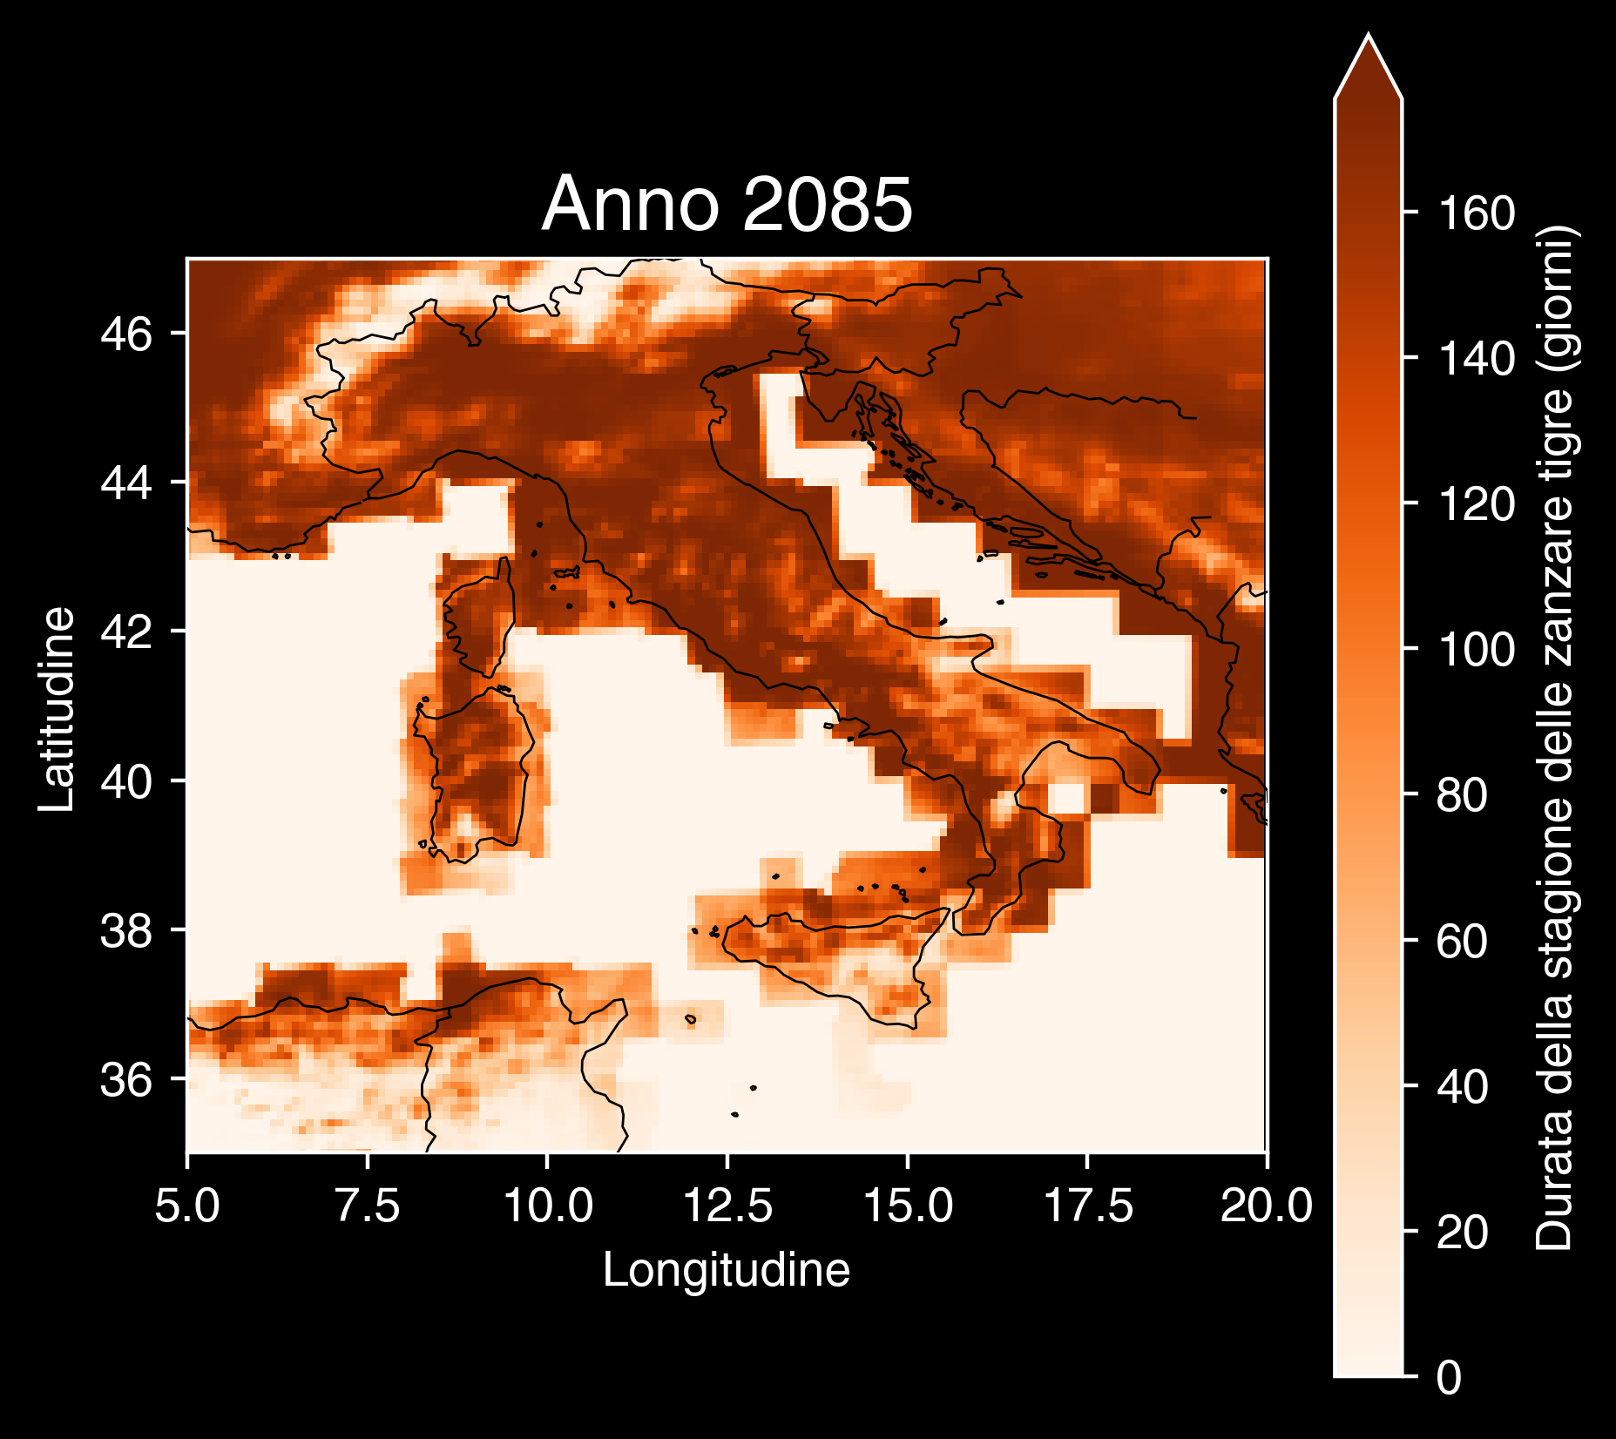
Copernicus Climate Change Service, Climate Data Store, (2019): Climatic suitability for the presence and seasonal activity of the Aedes albopictus mosquito for Europe derived from climate projections. Copernicus Climate Change Service (C3S) Climate Data Store (CDS). DOI: 10.24381/cds.d08ed09a

Slide 55
Le nostre scelte definiscono il cambiamento climatico

Slide 56
🥗Mangiamo consapevolmente.

Slide 57
🥗Mangiamo consapevolmente.
🚲Muoviamoci leggeri/e.

Slide 58
🥗Mangiamo consapevolmente.
🚲Muoviamoci leggeri/e.
🧑‍🚒Seguiamo la Protezione Civile locale.

Slide 59
🥗Mangiamo consapevolmente.
🚲Muoviamoci leggeri/e.
🧑‍🚒Seguiamo la Protezione Civile locale.
🗳️Ricordiamo l’importanza del nostro voto.

Slide 60

https://github.com/Robin-Castellani/pyconit25-future-climate-change

Slide 61

Feedback 👐

Slide 62
Qualcosa in più...
Perché non si sa mai...
😏

Slide 63
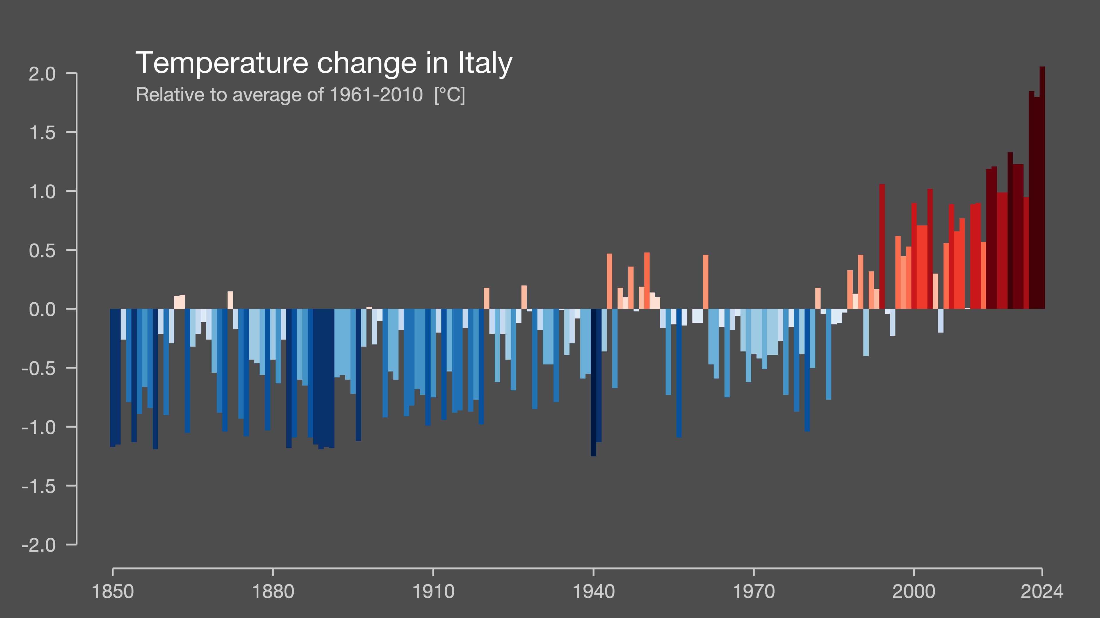
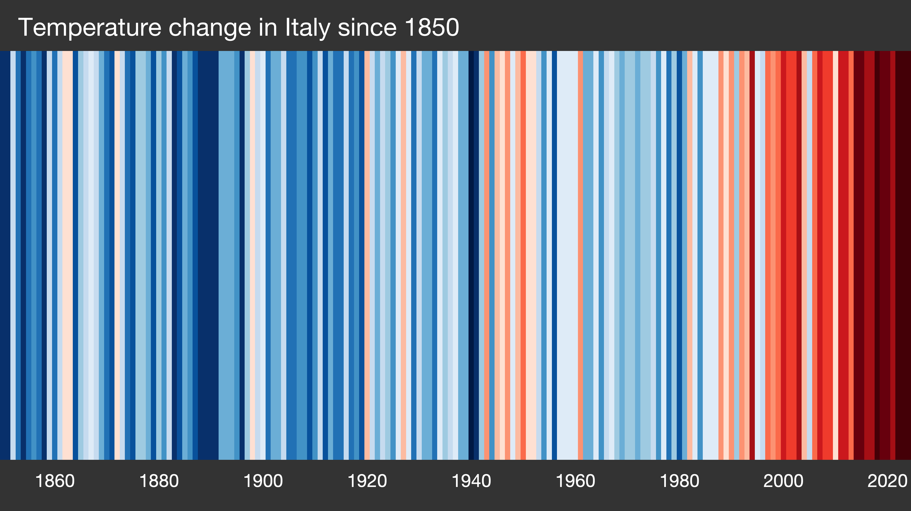
Showyourstripes.info by Ed Hawkins, University of Reading

Slide 64
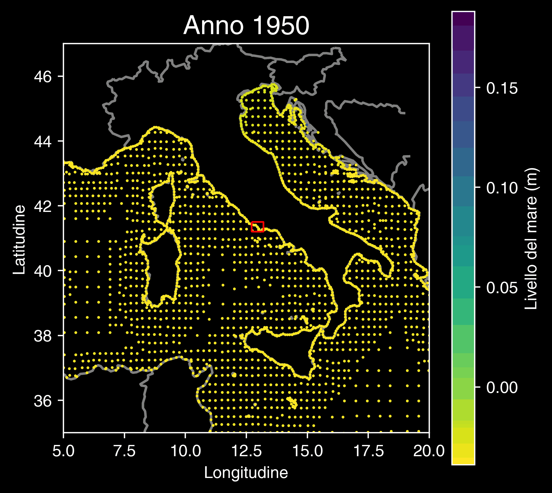
Copernicus Climate Change Service (2022): Global sea level change indicators from 1950 to 2050 derived from reanalysis and high resolution CMIP6 climate projections. Copernicus Climate Change Service (C3S) Climate Data Store (CDS). DOI: 10.24381/cds.6edf04e0

Slide 65
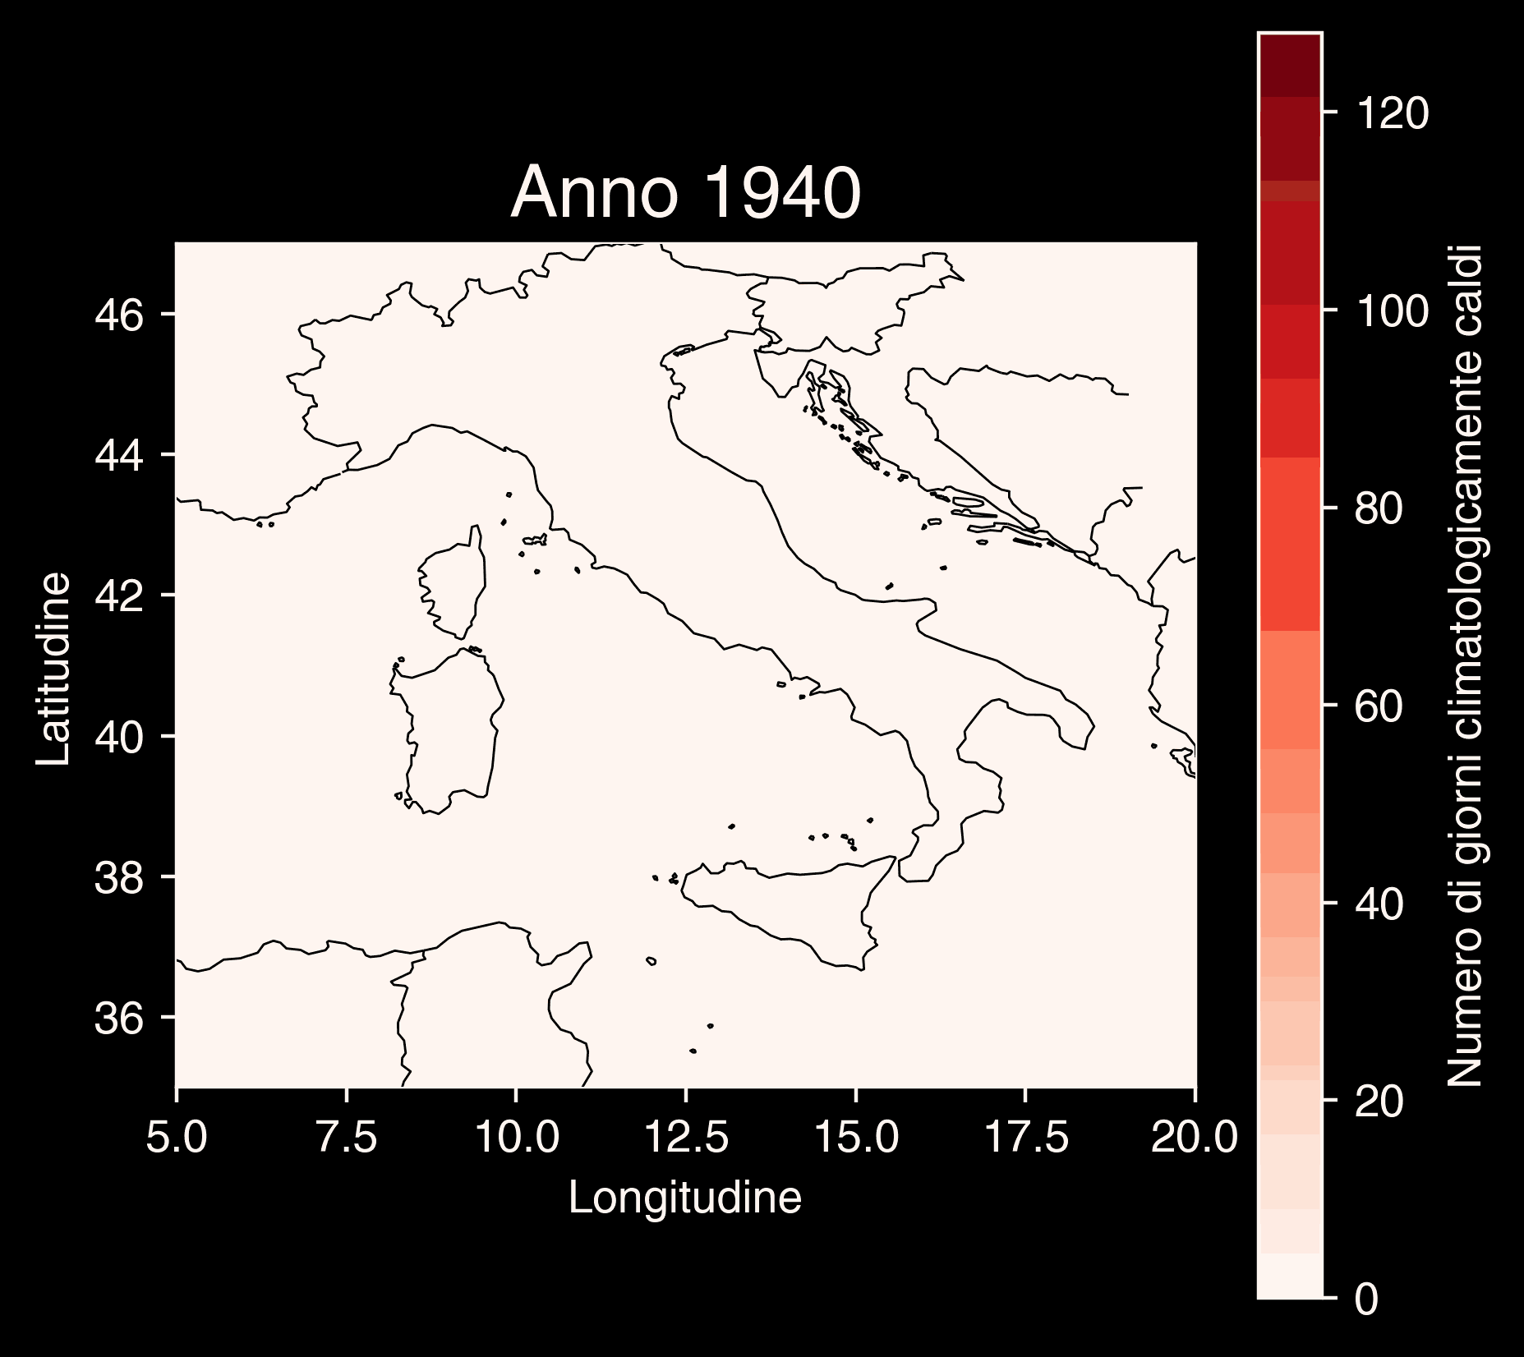
Copernicus Climate Change Service (C3S), Climate Data Store (CDS), (2024): Climate indicators for Europe from 1940 to 2100 derived from reanalysis and climate projections, Copernicus Climate Change Service (C3S) Climate Data Store (CDS).

Slide 66
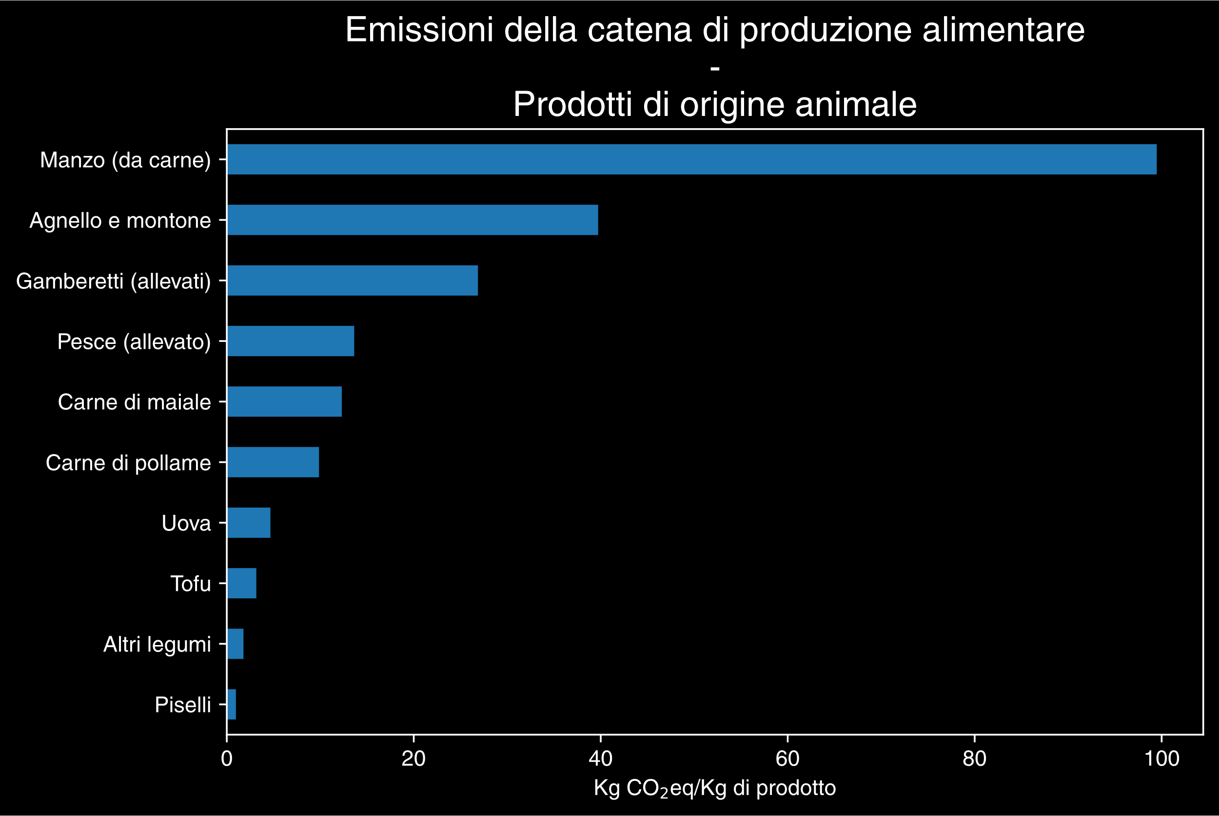
Hannah Ritchie, Pablo Rosado and Max Roser (2022) - “Environmental Impacts of Food Production” Published online at OurWorldinData.org. Retrieved from: 'https://ourworldindata.org/environmental-impacts-of-food' [Online Resource]

Slide 67
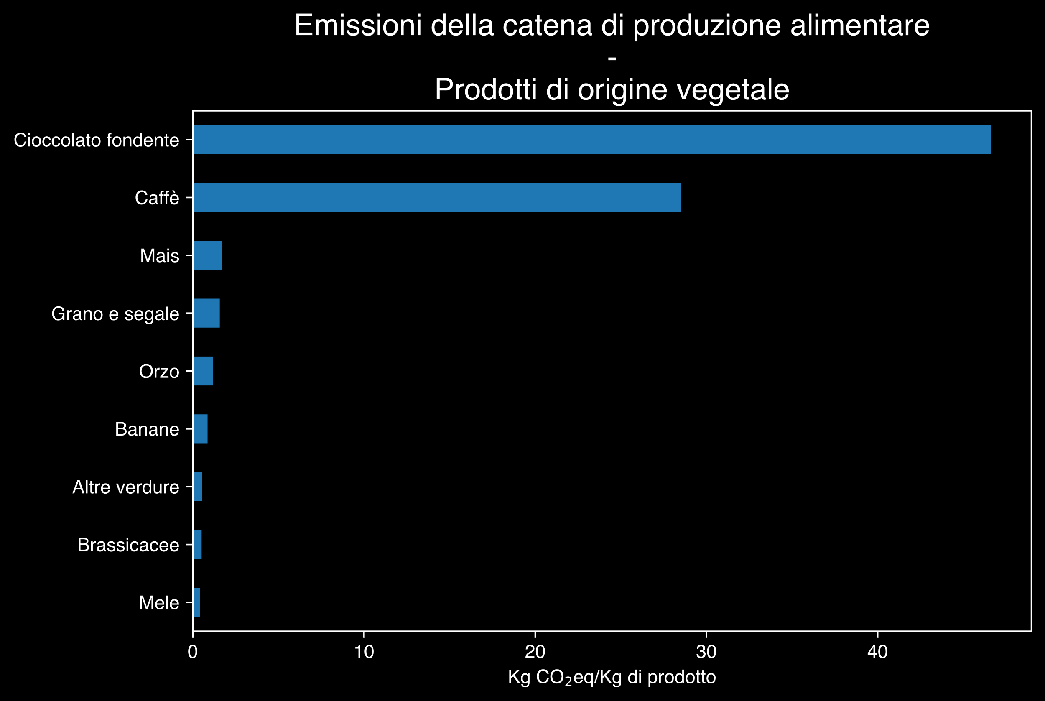
Hannah Ritchie, Pablo Rosado and Max Roser (2022) - “Environmental Impacts of Food Production” Published online at OurWorldinData.org. Retrieved from: 'https://ourworldindata.org/environmental-impacts-of-food' [Online Resource]

Slide 68
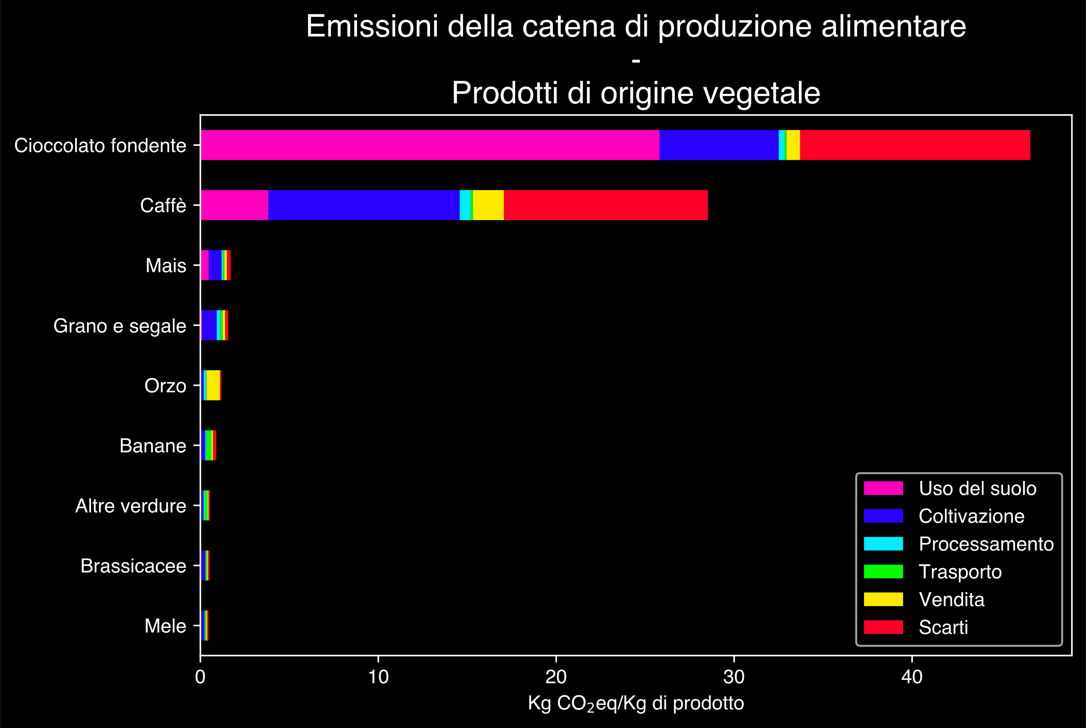
Hannah Ritchie, Pablo Rosado and Max Roser (2022) - “Environmental Impacts of Food Production” Published online at OurWorldinData.org. Retrieved from: 'https://ourworldindata.org/environmental-impacts-of-food' [Online Resource]

Slide 69
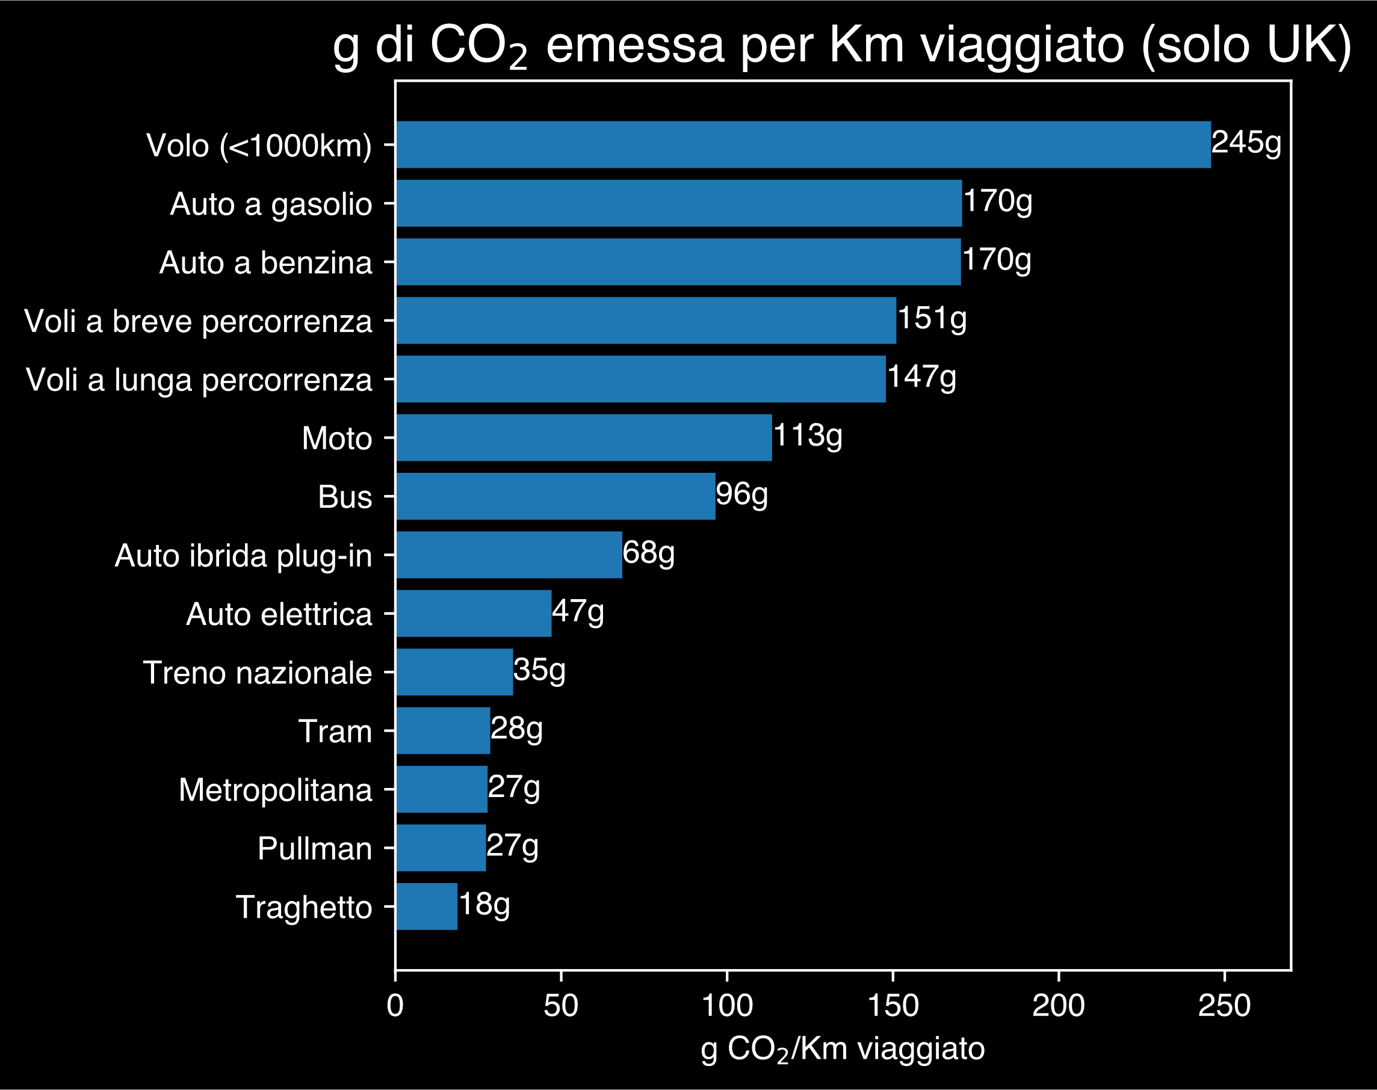
Hannah Ritchie (2023) - “Which form of transport has the smallest carbon footprint?” Published online at OurWorldinData.org. Retrieved from: 'https://ourworldindata.org/travel-carbon-footprint' [Online Resource]

